Slide 1
OHDSI Oncology Workshop
April 7, 2020

Slide 2
Agenda
Introduction to OHDSI (Peter R and Maxim M)
The mission, value, and objective
How we work together and what kind of evidence we’re generating
Introduction to the Oncology Extension
Challenges & Roadmap (Rimma B)
Data Model (Rimma B)
Standardizing Cancer Vocabulary (Christian R)
NAACCR ETL To Oncology Extension
Oncology CDM Extension Installation
NAACCR ETL Walkthru
Crosswalk to OMOP
Derivation of Episodes (Michael G and Anastasios S)
(Michael G)

Slide 3
Agenda
Need for OHDSI in the Cancer Registry (Gijs G)
Oncology CDM Use Cases (Chan Y)
Dutch and Norwegian Cancer Registries
Data collection methods/Coding methods/Current challenges (Chiara A, Siri L)
IKNL’s experience - Dutch national cancer registry (IKNL) to OMOP (Peter P)
PIONEER’s experience - Prostate Cancer Registry to OMOP (Maxim M)
SEER’s experience with OMOP (Angela M)
Areas of collaboration between the US and Non-US cancer registries – Open Discussion

Slide 4
The Journey to large-scale analytics
The Observational Health Data Sciences and Informatics (OHDSI) initiative
Introduction to the use of a Common Data Model and Standardized Vocabularies
The European Health Data and Evidence (EHDEN) Project
Examples of analytical use cases

Slide 5
Health Data Originates From Patient Journey

Slide 6
Each observational database is just an compilation of patient journeys

Slide 7
Questions asked across the patient journey

Slide 8
Observational Health Data Sciences and Informatics
Mission: To improve health by empowering a community to collaboratively generate the evidence that promotes better health decisions and better care
A multi-stakeholder, interdisciplinary, international collaborative with a coordinating center at Columbia University
http://ohdsi.org

Slide 9
OHDSI’s global research community

Slide 10
2019 OHDSI Data Network

Slide 11
The challenges of Real-World Data

Slide 12
Generating Reliable Evidence

Slide 13
Generating Reliable Evidence

Slide 14
OMOP CDM Version 6

Slide 15
Single Concept Reference Table

Slide 16
Generating Reliable Evidence

Slide 17
ETL Tooling

Slide 18
Standardized analytics with Atlas

Slide 19

Introduction to the Oncology Extension Rimma Belankar

Slide 20
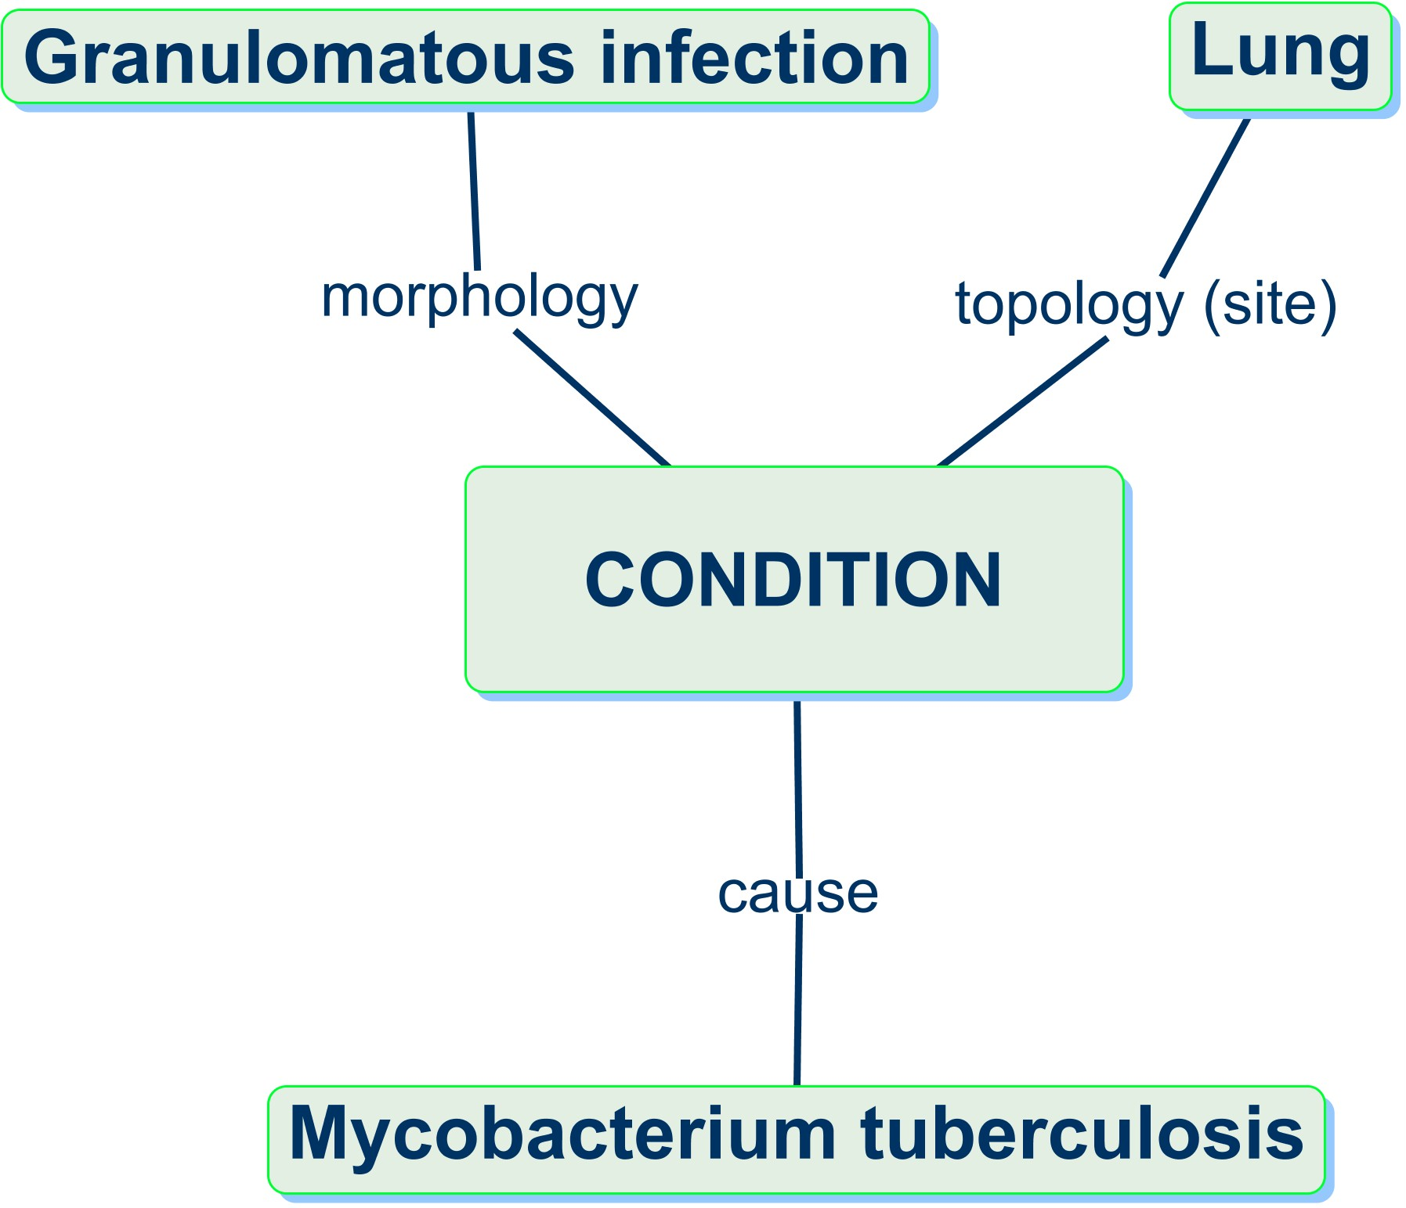
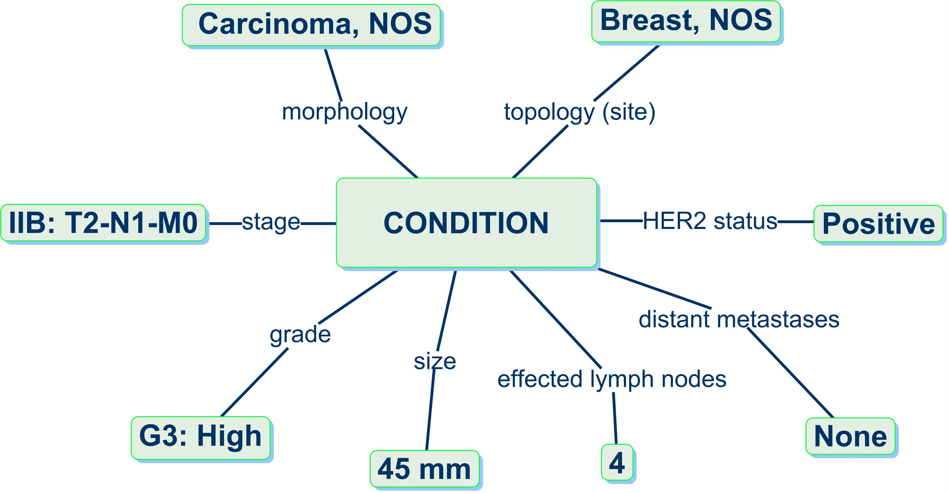
Challenges: Granularity
Normal Condition
Most normal conditions
are defined by three main
dimensions implicitly,
plus some extra attributes
Cancer
Cause is not known, but morphology and topology are detailed and explicit
The many tumor attributes (modifiers) are also explicit and well defined
Notes:
In a typical observational study, the definition of the study population (cohort), exposures and outcomes are usually based on diagnostic codes in addition to drug exposures, procedure occurrences or lab measurements.
For cancer studies, this information is typically not sufficient, as more details are required for the proper identification of the study population, treatment and subsequent outcomes.
Appropriate characterization of cancer requires details such as anatomical site, morphology, local penetration, affected lymph nodes, metastatic spread, biomarkers, and disease staging and grading. In typical observational data sources, this necessary level of detail is not regularly present.

Slide 21
Challenges: Treatment Identification
Correct identification of cancer treatment regimens tends to be more complex compared to other disease modalities within observational data.
Rarely treatment regimens are available in EMR
Most cancer treatments are administered in chemotherapy regimens with complex dosing and scheduling in multiple cycles and are often combined with targeted therapies, immunotherapies, surgery or radiotherapy.
None of these attributes follow standard definitions.
Many regimens are personalized to the individual patient need, making a priori standardized definitions more complex.

Slide 22
Challenges: Abstraction
Clinically and analytically relevant representation of cancer diagnoses, treatments, and outcomes requires data abstraction
Not readily available in the source data
Traditionally not supported in OMOP CDM
1st disease occurrence
Remission
Progression
Stable disease
Progression
Diagnosis
Palliative Care
Hospice/EOL
Treatments
1st treatment course
2nd treatment course
3rd and 4th treatment courses
Notes:
Abstraction Challenge
Additionally, clinically relevant information on disease, treatment and outcomes that appropriately reflects a patient’s journey including information on the time of diagnosis, response to treatments, time to treatment failure, disease progression, recurrence and (disease-free and overall) survival requires data abstraction and is rarely available in the source data and has not been traditionally supported in OMOP CDM.

Slide 23
Challenges: Variety of Representations
Variety of Sources
Cancer Registries with different and changing requirements
Various EHR systems with no standard Oncology interfaces
Variety of Standards
No single standard in any oncology domains
Standards change along with the field advancements

Slide 24
Oncology Workgroup Goals
Create an OMOP CDM and Vocabulary foundation for representing cancer data at the levels of granularity and abstraction required to support observational cancer research
Establish Oncology-specific THEMIS conventions
Develop / support ETL for tumor registry and EHR data
Create Use-case-driven algorithms for
identifying & characterizing cancer populations
identifying treatment pathways and disease progression
predicting disease progression
https://github.com/OHDSI/OncologyWG/wiki

Slide 25
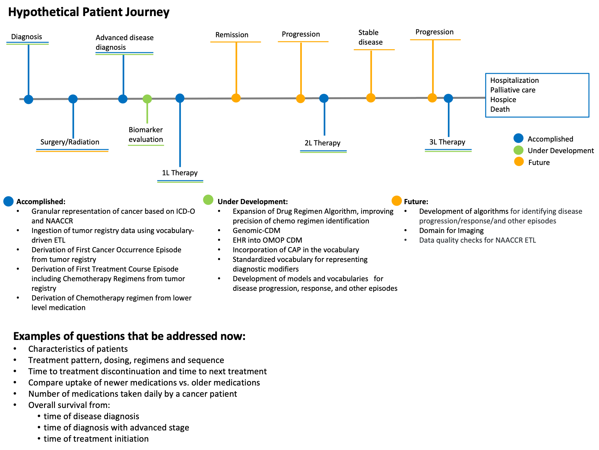
Roadmap
Notes:
The extension has been tested in EHR and Cancer Registry data against a number of typical use cases.

Slide 26
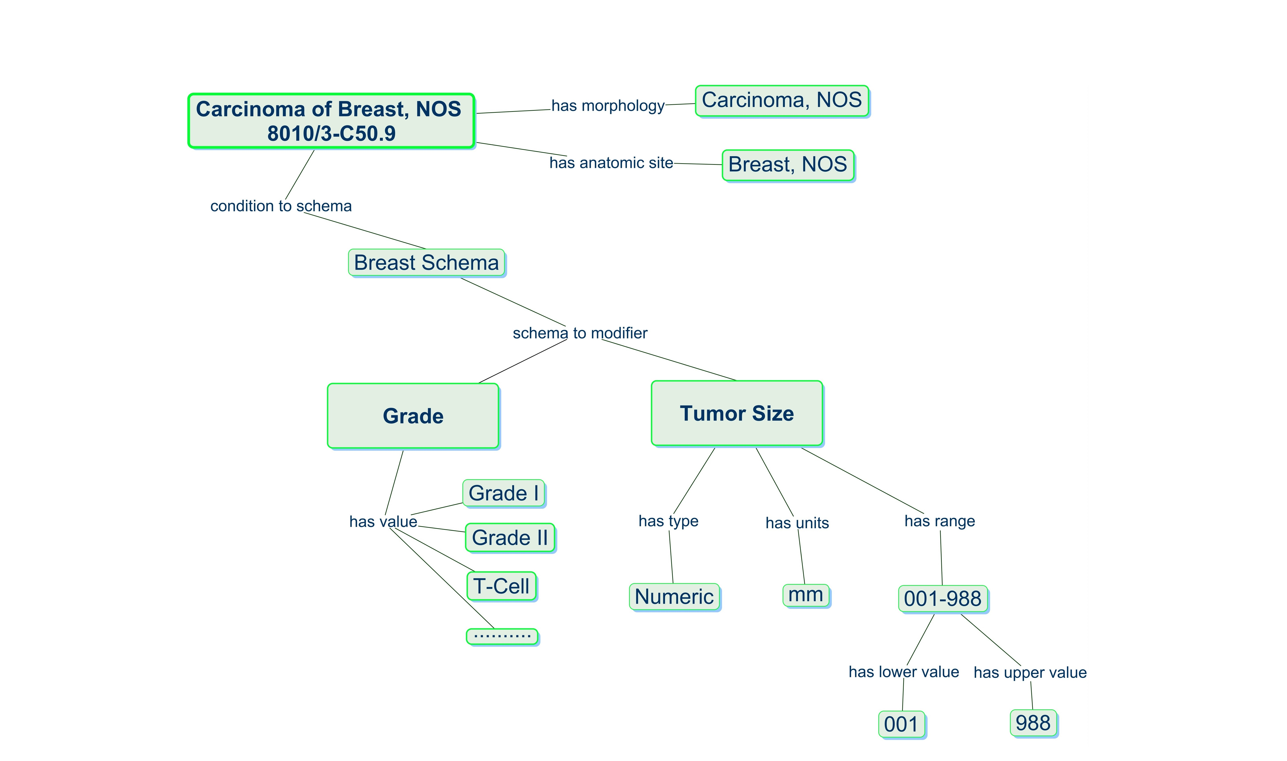
Solving Granularity Challenge
Cancer Diagnosis Model in the OMOP Vocabulary
Added vocabularies:
Notes:
Add ICD-O and mapped to SNOMED, NAACCR,

Slide 27
Solving Granularity Challenge

Slide 28
Solving Granularity Challenge

Slide 29
Solving Abstraction Challenge
Added vocabularies:

Slide 30
Solving Abstraction Challenge
Added vocabularies:

Slide 31



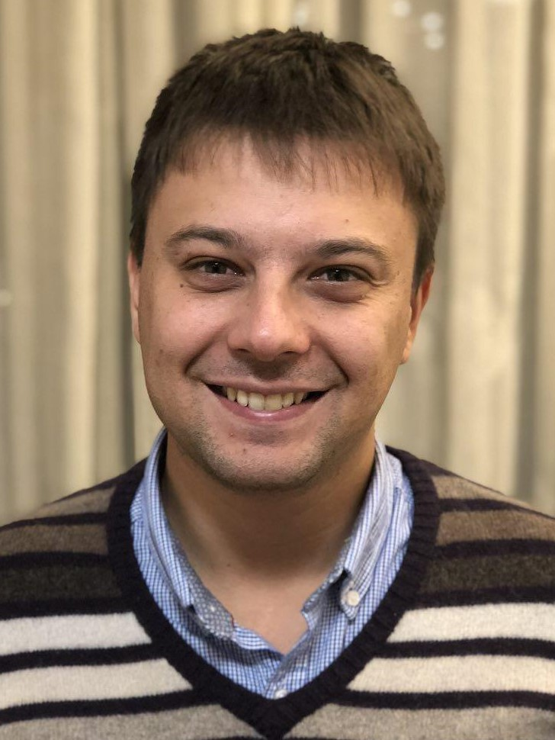











OHDSI Oncology WG
Shilpa
Ratwani
Michael
Gurley
Christian
Reich
Dmitry
Dymshyts
Robert
Miller
Andrew Williams
Seng Chan You
Rimma
Belenkaya
Scott Campbell, University of Nebraska, US
RuiJun Chen, Columbia University, US
Asieh Golozar, Regeneron, US
Eduard Korchmar, Odysseys, US
Vlad Korsik, , Odysseys, US
George Hripcsak, Columbia University, US
Maxim Moinat, The Hyve, Netherlands
Meera Patel, MSK, US
Gurvaneet Randhawa, NCI, US
Donna Rivera, NIH, US
Anastasios Siapos, IQVIA , Great Britain
Jeremy Warner, Vanderbilt University, US

Slide 32
Standardizing Cancer Vocabularies
Christian Reich

Slide 33
Standardizing is hard, cancer is harder
Semantic complexity
Way more detailed conditions
Why more complex treatments
Constant change
Imaging
Genomics
More and different sources
EHR (standard or registry)
Pathology reports
Registries
Clinical trials
Disparate quality

Slide 34
OMOP Vocabulary Principle
Incorporate (=steal), don’t invent
Pick by
Comprehensiveness
Quality
Ontological principles: Concepts, life cycle, existing relationships to other
Use Open Source, give credit
Pick, de-ambiguate, map

Slide 35
Standardizing Bodies
Organization
World Health Organization (WHO)
Logical Observation Identifiers Names and Codes (LOINC)
Systematic Nomenclature of Medicine
American Joint Commission on Cancer (AJCC), Union for International Cancer Control (UICC)
College of American Pathologists (CAP)
North American Association of Central Cancer Registries (NAACCR)
US International
X
X X
X X
X
X
X
X

Slide 36
Not easy – Example NAACCR
Duplication
3843 Grade Pathological
3844 Grade Pathological
3845 Grade Post Therapy
3845 Grade Post Therapy
Ambiguity
Lip
Other Lip (excluding Malignant Melanoma)
Lip, Upper (excluding Malignant Melanoma)
Lip, Lower (excluding Malignant Melanoma)
Malignant Melanoma of Upper Lip
Malignant Melanoma of Lower Lip
Malignant Melanoma of Other Lip
Malignant Melanoma of Pharynx, NOS and Overlapping Lesions of Lip, Oral Cavity, and Pharynx
Pharynx, NOS, and Overlapping Lesion of Lip, Oral Cavity, and Pharynx (excluding Malignant Melanoma)

Slide 37
NAACCR ETL to the
Oncology CDM Extension
Michael Gurley
Northwestern University
Applied Research Informatics Group
m-gurley@northwestern.edu

Slide 38
Oncology CDM Extension Installation
Detailed install instructions:
https://github.com/OHDSI/OncologyWG/wiki/Oncology-CDM-Extension-Installation
Not yet been incorporated into an official OMOP CDM release.
v5.31
PostgreSQL, SQL Server, Oracle and Redshift

Slide 39
Oncology CDM Extension Installation
Step 1: Compile the OMOP CDM v5.31 Tables.
Step 2: Compile the Oncology CDM Extension Tables: EPISODE, EPISODE_EVENT, MEASUREMENT, CONCEPT_NUMERIC.
Step 3: Load the OMOP Standardized Vocabulary Tables.
Athena: SNOMED, ICDO-3, HemOnc, RxNorm, NAACCR, and Episode Type
Vocabulary patch file: Execute the vocabulary patch file from the OncologyWG Github repository to support metadata description/reference of the Oncology CDM Extension's new tables and added columns.
CONCEPT_NUMERIC: Run the vocabulary ingestion script to populate the Oncology CDM Extension's newly added CONCEPT_NUMERIC vocabulary table from the OncologyWG Github repository.
Step 4: ETL the OMOP Standardized Clinical Data Tables
Some implementations will layer the ETL of data into the Oncology CDM Extension tables on top of an OMOP CDM instance populated from other sources.
Other implementations will ETL data into the Oncology CDM Extension tables in a satellite OMOP CDM instance and merge the data into a main OMOP CDM instance.
Step 5: Compile the indexes and constraints.
Compile the OMOP CDM v5.31 indexes and constraints from the OHDSI/CommonDataModel Github repository.
Compile the Oncology CDM Extension constraints from the OncologyWG Github repository.

Slide 40
Populating the Oncology CDM Extension
https://github.com/OHDSI/OncologyWG/wiki/Populating-the-OMOP-Oncology-Extension
Directly from Tumor Registries:
ETL Disease Episodes, Disease Episode Modifiers, Treatment Episodes and Treatment Episode Modifiers directly from tumor registry data. Tumor registries natively capture many of the abstractions and detailed modifiers that the Oncology CDM Extension strives to instantiate. A standard ETL has been written capable of ETLing NAACCR-formatted tumor registry data.

Slide 41
Populating the Oncology CDM Extension
Directly from non-registry sources:
Treatment Episode Modifiers directly from
EHR systems
Ancillary clinical systems: imaging, pathology.
Oncology Analytic Platforms
Custom clinical data repositories.
Some non-registry sources natively capture and/or curate the abstractions and detailed modifiers that the Oncology CDM Extension strives to instantiate.

Slide 42
Populating the Oncology CDM Extension
Indirectly via Algorithmic Derivation on top of the OMOP CDM:
Run algorithms on top of the OMOP standardized clinical data tables. For example, machine learning, rules-based compendium-aided temporal logic, and natural language processing. ETL Disease Episodes, Disease Episode Modifiers, Treatment Episodes and Treatment Episode Modifiers from the outputs of these algorithms.

Slide 43
NAACCR ETL Walkthrough:
NAACCR Data Dictionary
https://github.com/OHDSI/OncologyWG/wiki/NAACCR-ETL-Walkthrough
NAACCR Data Dictionary
NAACCR (North American Association of Central Cancer Registries) is the organization that governs the data dictionary format that is used to standardize the encoding and transmission of tumor registry data in the United States.
All healthcare facilities in the United States that diagnose or treat cancer patients are mandated to track and collect cancer data and submit it in the NAACCR data dictionary format for all first-course diagnosed/treated primary tumors.
SEER, NCDB, state registries.

Slide 44
NAACCR ETL Walkthrough:
NAACCR Data Dictionary
The NAACCR data dictionary format most importantly covers the following areas:
Demographics
Cancer Identification
Stage/Prognostic Factors
Treatment-1st Course
Follow-up/Recurrence/Death

Slide 45
NAACCR ETL Walkthrough:
NAACCR Data Dictionary
NAACCR data is generally considered a gold-standard source for the following areas:
Disease First Occurrence: Fine-grained first occurrence cancer diagnosis date and characterization via the collection of ICDO-3 site/histology.
Diagnostic Modifiers: Detailed staging and prognostic factors (clinical and pathological TNM Staging, grade, lymphatic invasion, biomarkers, and other data points) curated from oncology progress notes and pathology reports that are not normally discretely captured in EHRs and or claims databases.
First-course Treatment: Overall treatment modality and high-value treatment modifiers.
Death and Survival.
NAACCR data is generally considered to be a valuable but not gold-standard source for the following area:
Disease outcomes: 'Disease Remission', 'Disease Recurrence', 'Disease Progression', and 'Disease Metastasis'.

Slide 46
NAACCR ETL Walkthrough:
NAACCR Data Dictionary
The NAACCR data dictionary format is a question/answer or EAV format that mixes:
De novo definition of data points.
Sourcing of data points from existing standard bodies: cancer diagnosis (site/histology) from ICDO-3 via WHO; staging variables and values from AJCC.

Slide 47
NAACCR ETL Walkthrough:
NAACCR Data Dictionary
The NAACCR data dictionary format and the source ICDO-3 vocabulary have been ingested into the OMOP vocabulary.
The Hemonc.org oncology drug regimen ontology has been ingested into the OMOP vocabulary. Some treatment NAACCR item coded values are mapped to Hemonc.org 'Modality' concepts.

Slide 48
NAACCR ETL Walkthrough:
NAACCR ETL
The OHDSI Oncology Development Subgroup has created a standardized ETL to ingest NAACCR data into the Oncology CDM Extension.
The ETL is a SQL script that assumes your NAACCR data has been transformed into a common EAV input format.
The SQL script uses the common NAACCR data dictionary input format in conjunction with the ICDO-3, NAACCR, and Hemonc.org vocabularies within the OMOP vocabulary tables.

Slide 49
NAACCR ETL Walkthrough:
NAACCR ETL
Cancer Diagnoses: Mapping of ICDO-3 site and histology and diagnosis dates present in NAACCR data to insert low-level cancer diagnoses into the CONDITION_OCCURRENCE table and 'Disease First Occurrence' disease episodes into the EPISODE table.

Slide 50
NAACCR ETL Walkthrough:
NAACCR ETL
Diagnosis Modifiers: Mapping of NAACCR staging and prognostic factors present in NAACCR data to insert low-level diagnostic modifiers into the MEASUREMENT table pointing to the CONDITION_OCCURRENCE table and episode modifiers into the MEASUREMENT table pointing to the 'Disease First Occurrence' disease episode it inserts into the EPISODE table.

Slide 51
NAACCR ETL Walkthrough:
NAACCR ETL
Cancer Treatments: Mapping of NAACCR treatment variables and treatment dates present in NAACCR data to insert low-level treatments into the PROCEDURE_OCCURRENCE and DRUG_EXPOSURE tables and 'Treatment Regimen' treatment episodes into the EPISODE table.
For surgical and radiation therapy treatments, the script places NAACCR item code values into the EPISODE.episode_object_concept_id column. For drug treatments, the script places into the EPISODE.episode_object_concept_id column mappings from non-standard NAACCR items code values to Hemonc.org 'Modality' concepts:
35803401 Chemotherapy
35803410 Immunotherapy
35803407 Hormonotherapy

Slide 52
NAACCR ETL Walkthrough:
NAACCR ETL
Episode Linking: Linking child first-course ‘Treatment Regimen' treatment episodes to parent 'Disease First Occurrence' disease episode via the column EPISODE.episode_parent_id.

Slide 53
NAACCR ETL Walkthrough:
NAACCR ETL
Treatment Modifiers: Mapping of NAACCR treatment attribute variables present in NAACCR data to insert low-level treatment modifiers into the MEASUREMENT table pointing to the PROCEDURE_OCCURENECE table and episode modifiers into the MEASUREMENT table pointing to the 'Treatment Regimen' treatment episodes it inserts into the EPISODE table.

Slide 54
NAACCR ETL Walkthrough:
NAACCR ETL
Persons: Inserting persons into the PERSON table if no such person_id exists in the PERSON table. The ETL will also insert an entry in the OBSERVATION_PERIOD table based on survival variables present in the NAACCR data. This is to help support the strategy of ETLing data into the Oncology CDM Extension tables in a satellite OMOP CDM instance and merging the data into a main OMOP CDM instance.

Slide 55
NAACCR ETL Walkthrough:
NAACCR ETL
Death: Inserting a date entry in the DEATH table if the death variable present in the NAACCR data indicates that the patient is deceased. If prior information in the DEATH table conflicts with death data present in the NAACCR data the ETL refrains from updating the DEATH table.

Slide 56
NAACCR ETL Walkthrough:
NAACCR ETL
Survival: Updates the OBSERVATION_PERIOD.observation_period_start_date and OBSERVATION_PERIOD.observation_period_end_date for patients that have survival variables present in the NAACCR data that indicate longer survival.

Slide 57
NAACCR ETL Walkthrough:
NAACCR ETL Installation
Install the Oncology CDM Extension.
Install the common NAACCR data dictionary input format: NAACCR_DATA_POINTS
Install an ancillary provenance table to aid data quality checks: CDM_SOURCE_PROVENANCE

Slide 58
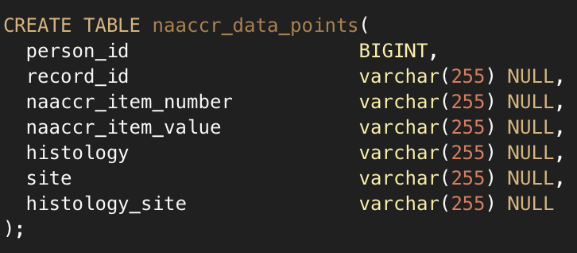
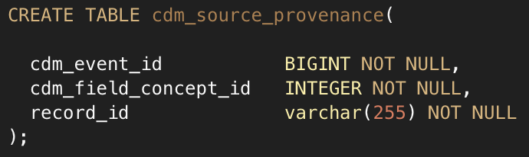
NAACCR ETL Walkthrough:
NAACCR ETL Installation

Slide 59
Populate the NAACCR_DATA_POINTS Input Format
The NAACCR data dictionary format is natively a flat or pivoted format.
Currently, the OHDSI Oncology Development Subgroup supports two methods to convert and populate the NAACCR_DATA_POINTS input format from native NAACCR data.
The OHDSI Oncology Development Subgroup has developed an R package to parse NAACCR flat-file format v15-18 and ingest it into the NAACCR_DATA_POINTS input format.
The OHDSI Oncology Development Subgroup has developed a script to transform the relational model of Elekta METRIQ (the most popular tumor registry software).
All methods of transforming the NAACCR data to the NAACCR_DATA_POINTS input format will need to include a method to populate the NAACCR_DATA_POINTS.person_id column.

Slide 60
NAACCR ETL Walkthrough:
Executing the NAACCR ETL SQL
https://github.com/OHDSI/OncologyWG/tree/master/etl
The NAACCR ETL SQL has been written in vanilla SQL to help facilitate it being run on multiple different database platforms.
Use SqlRender to translate to: PostgreSQL, Oracle, Sql Serve, and Redshift.
The NAACCR ETL SQL is wrapped in a database transaction to support the complete rollback of data changes.

Slide 61
NAACCR ETL Walkthrough:
NAACCR ETL SQL Unit Testing
The NAACCR ETL SQL has a full-coverage unit test suite

Slide 62
NAACCR Crosswalk to OMOP
https://github.com/OHDSI/OncologyWG/wiki/naaccr-crosswalk#Crosswalk-between-NAACCR-and-OMOP
https://github.com/OHDSI/OncologyWG/wiki/NAACCR-Disease-Episodes

Slide 63
Derivation of Episodes Anastasios Siapos

Slide 64
Cancer Research - Abstraction
Clinically and analytically relevant representation of cancer diagnoses, treatments, and outcomes requires data abstraction
Not readily available in the source data
Traditionally not supported in OMOP CDM
1st disease occurrence
Remission
Progression
Stable disease
Progression
Diagnosis
Palliative Care
Hospice/EOL
Treatments
1st treatment course
2nd treatment course
3rd and 4th treatment courses

Slide 65
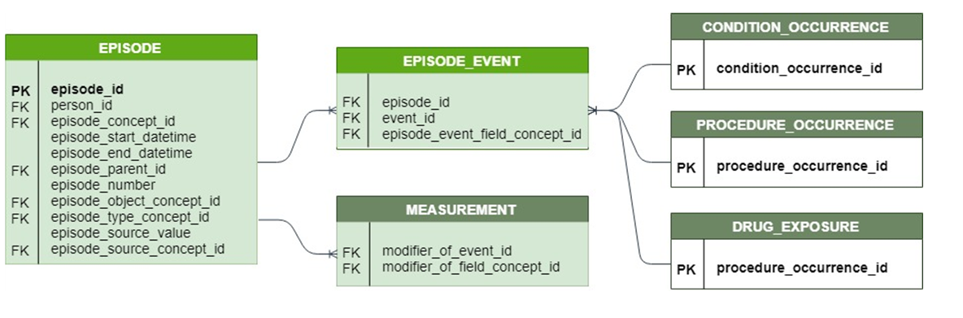
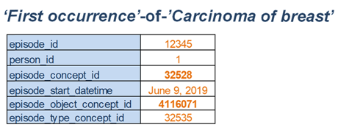
Cancer Research – Solving Abstraction
Added vocabularies:
Disease and treatment in the OMOP CDM

Slide 66
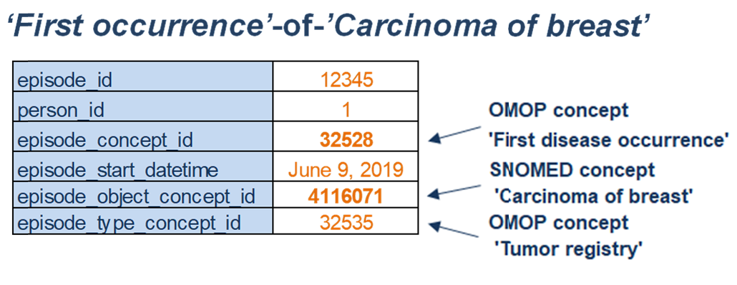
Cancer Research – Solving Abstraction
Added vocabularies:
Disease and treatment in the OMOP CDM

Slide 67
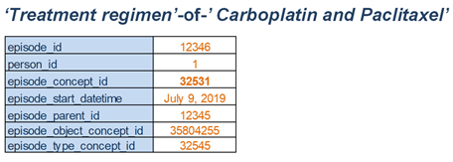
Cancer Research – Solving Abstraction
Added vocabularies:
Disease and treatment in the OMOP CDM

Slide 68
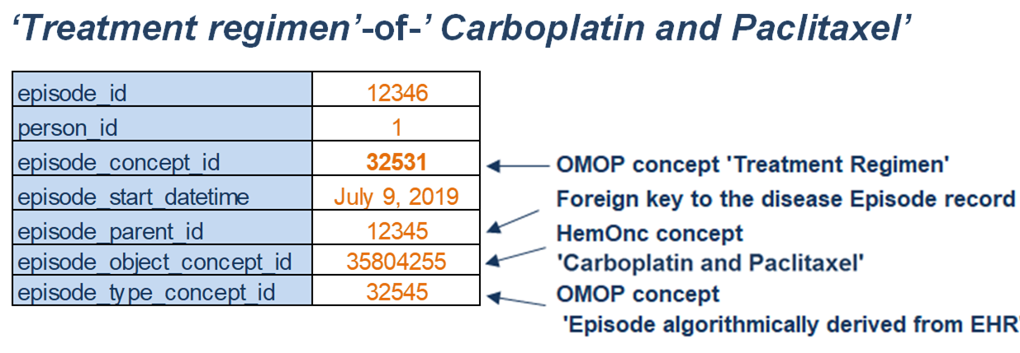
Cancer Research – Solving Abstraction
Added vocabularies:
Disease and treatment in the OMOP CDM

Slide 69
Drug Regimen Algorithm - Package Structure
OHDSI gold standard for packages
Version 1 of the package was implemented by using the OHDSI gold standard for packages.
This ensures that the algorithm is:
Simple
Readable
Consistent with other OHDSI packages
Testable

Slide 70
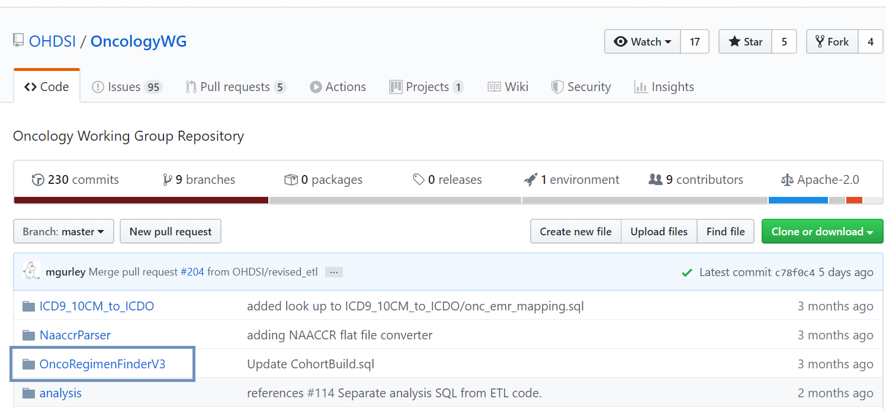
Drug Regimen Extraction - Package Structure
OHDSI gold standard for packages
Version 1 of the package was implemented by using the OHDSI gold standard for packages.
This ensures that the algorithm is:
Simple
Readable
Consistent with other OHDSI packages
Testable
Version 1 of the package was successfully run across: 4 different SQL dialects
6 collaborator data assets ( incl. Columbia University, Tufts University, Northwestern University)

Slide 71
Algorithm – Rule based approach

Slide 72
Algorithm - Procedure
Identify all the “Antineoplastic agents”
and the “Immunosapresants” through the drug_era table

Slide 73
Algorithm - Procedure
Identify all the “Antineoplastic agents”
and the “Immunosapresants” through the drug_era table
The results are ordered by date

Slide 74
Algorithm - Procedure
Identify all the “Antineoplastic agents”
and the “Immunosapresants” through the drug_era table
The results are ordered by date
Ingredients with consequent eras and start dates that occur within a 30 days period are identified

Slide 75
Algorithm - Procedure
Identify all the “Antineoplastic agents”
and the “Immunosapresants” through the drug_era table
The results are ordered by date
Ingredients with consequent eras and start dates that occur within a 30 days period are identified
Lines of treatments with distinct ingredients are generated

Slide 76
Algorithm - Procedure
Identify all the “Antineoplastic agents”
and the “Immunosapresants” through the drug_era table
The results are ordered by date
Ingredients with consequent eras and start dates that occur within a 30 days period are identified
Lines of treatments with distinct ingredients are generated
HemOnc vocabulary is used to identify oncology regimens

Slide 77
Algorithm - Procedure
Identify all the “Antineoplastic agents”
and the “Immunosapresants” through the drug_era/drug_exposure table
The results are ordered by date
Ingredients with consequent eras and start dates that occur within a 30 days period are identified
Oncology regimens stored in the episode and episode event tables
Lines of treatments with distinct ingredients are generated
HemOnc vocabulary is used to identify oncology regimens

Slide 78
Examples

Slide 79
Examples
Data for person_id = 1692
Input:
Output
Step 1
concept_name | drug_exposure_id | person_id | drug_concept_id | start_date
etoposide | 38969543 | 1692 | 19077215 | 12/7/2016
etoposide | 27876058 | 1692 | 40041386 | 12/7/2016
carboplatin | 27876060 | 1692 | 40022178 | 12/7/2016
etoposide | 8542664 | 1692 | 40041386 | 12/8/2016
etoposide | 37216873 | 1692 | 40041386 | 12/9/2016
etoposide | 6157373 | 1692 | 40041386 | 12/28/2016
carboplatin | 6157375 | 1692 | 40022178 | 12/28/2016
etoposide | 20227519 | 1692 | 40041386 | 12/29/2016
etoposide | 8609989 | 1692 | 40041386 | 12/30/2016
etoposide | 15655753 | 1692 | 40041386 | 1/18/2017
carboplatin | 15655755 | 1692 | 40022178 | 1/18/2017
etoposide | 4508082 | 1692 | 40041386 | 1/19/2017
etoposide | 11422068 | 1692 | 40041386 | 1/20/2017
etoposide | 24900262 | 1692 | 40041386 | 2/8/2017
carboplatin | 24900264 | 1692 | 40022178 | 2/8/2017
etoposide | 23719345 | 1692 | 40041386 | 2/9/2017
etoposide | 13787826 | 1692 | 40041386 | 2/10/2017
pembrolizumab | 34940090 | 1692 | 46276411 | 6/21/2017
pembrolizumab | 9194796 | 1692 | 46276411 | 7/12/2017
pembrolizumab | 37177882 | 1692 | 46276411 | 8/2/2017
pembrolizumab | 4515657 | 1692 | 46276411 | 8/23/2017
person_id | regimen_start_date | ingredient | concept_id | Regimen name
1692 | 12/7/2016 | carboplatin | 35806400 | Carboplatin and Etoposide
1692 | 12/7/2016 | etoposide | 35806400 | Carboplatin and Etoposide
1692 | 6/21/2017 | pembrolizumab | 35803678 | Pembrolizumab monotherapy
person_id | regimen_start_date | concept_id | Regimen name
1692 | 12/7/2016 | 35806400 | Carboplatin and Etoposide
1692 | 6/21/2017 | 35803678 | Pembrolizumab monotherapy

Slide 80
Examples
Data for person_id = 1692
Input:
Output
Step 1
Step 2
concept_name | drug_exposure_id | person_id | drug_concept_id | start_date
etoposide | 38969543 | 1692 | 19077215 | 12/7/2016
etoposide | 27876058 | 1692 | 40041386 | 12/7/2016
carboplatin | 27876060 | 1692 | 40022178 | 12/7/2016
etoposide | 8542664 | 1692 | 40041386 | 12/8/2016
etoposide | 37216873 | 1692 | 40041386 | 12/9/2016
etoposide | 6157373 | 1692 | 40041386 | 12/28/2016
carboplatin | 6157375 | 1692 | 40022178 | 12/28/2016
etoposide | 20227519 | 1692 | 40041386 | 12/29/2016
etoposide | 8609989 | 1692 | 40041386 | 12/30/2016
etoposide | 15655753 | 1692 | 40041386 | 1/18/2017
carboplatin | 15655755 | 1692 | 40022178 | 1/18/2017
etoposide | 4508082 | 1692 | 40041386 | 1/19/2017
etoposide | 11422068 | 1692 | 40041386 | 1/20/2017
etoposide | 24900262 | 1692 | 40041386 | 2/8/2017
carboplatin | 24900264 | 1692 | 40022178 | 2/8/2017
etoposide | 23719345 | 1692 | 40041386 | 2/9/2017
etoposide | 13787826 | 1692 | 40041386 | 2/10/2017
pembrolizumab | 34940090 | 1692 | 46276411 | 6/21/2017
pembrolizumab | 9194796 | 1692 | 46276411 | 7/12/2017
pembrolizumab | 37177882 | 1692 | 46276411 | 8/2/2017
pembrolizumab | 4515657 | 1692 | 46276411 | 8/23/2017
person_id | regimen_start_date | ingredient | concept_id | Regimen name
1692 | 12/7/2016 | carboplatin | 35806400 | Carboplatin and Etoposide
1692 | 12/7/2016 | etoposide | 35806400 | Carboplatin and Etoposide
1692 | 6/21/2017 | pembrolizumab | 35803678 | Pembrolizumab monotherapy
person_id | regimen_start_date | concept_id | Regimen name
1692 | 12/7/2016 | 35806400 | Carboplatin and Etoposide
1692 | 6/21/2017 | 35803678 | Pembrolizumab monotherapy

Slide 81
Examples
Data for person_id = 1692
Input:
Output
Step 1
Step 2
Step 3a
Step 3b
concept_name | drug_exposure_id | person_id | drug_concept_id | start_date
etoposide | 38969543 | 1692 | 19077215 | 12/7/2016
etoposide | 27876058 | 1692 | 40041386 | 12/7/2016
carboplatin | 27876060 | 1692 | 40022178 | 12/7/2016
etoposide | 8542664 | 1692 | 40041386 | 12/8/2016
etoposide | 37216873 | 1692 | 40041386 | 12/9/2016
etoposide | 6157373 | 1692 | 40041386 | 12/28/2016
carboplatin | 6157375 | 1692 | 40022178 | 12/28/2016
etoposide | 20227519 | 1692 | 40041386 | 12/29/2016
etoposide | 8609989 | 1692 | 40041386 | 12/30/2016
etoposide | 15655753 | 1692 | 40041386 | 1/18/2017
carboplatin | 15655755 | 1692 | 40022178 | 1/18/2017
etoposide | 4508082 | 1692 | 40041386 | 1/19/2017
etoposide | 11422068 | 1692 | 40041386 | 1/20/2017
etoposide | 24900262 | 1692 | 40041386 | 2/8/2017
carboplatin | 24900264 | 1692 | 40022178 | 2/8/2017
etoposide | 23719345 | 1692 | 40041386 | 2/9/2017
etoposide | 13787826 | 1692 | 40041386 | 2/10/2017
pembrolizumab | 34940090 | 1692 | 46276411 | 6/21/2017
pembrolizumab | 9194796 | 1692 | 46276411 | 7/12/2017
pembrolizumab | 37177882 | 1692 | 46276411 | 8/2/2017
pembrolizumab | 4515657 | 1692 | 46276411 | 8/23/2017
person_id | regimen_start_date | ingredient | concept_id | Regimen name
1692 | 12/7/2016 | carboplatin | 35806400 | Carboplatin and Etoposide
1692 | 12/7/2016 | etoposide | 35806400 | Carboplatin and Etoposide
1692 | 6/21/2017 | pembrolizumab | 35803678 | Pembrolizumab monotherapy
person_id | regimen_start_date | concept_id | Regimen name
1692 | 12/7/2016 | 35806400 | Carboplatin and Etoposide
1692 | 6/21/2017 | 35803678 | Pembrolizumab monotherapy

Slide 82
Examples
Data for person_id = 1692
Input:
Output
Step 1
Step 2
Step 3a
Step 3b
concept_name | drug_exposure_id | person_id | drug_concept_id | start_date
etoposide | 38969543 | 1692 | 19077215 | 12/7/2016
etoposide | 27876058 | 1692 | 40041386 | 12/7/2016
carboplatin | 27876060 | 1692 | 40022178 | 12/7/2016
etoposide | 8542664 | 1692 | 40041386 | 12/8/2016
etoposide | 37216873 | 1692 | 40041386 | 12/9/2016
etoposide | 6157373 | 1692 | 40041386 | 12/28/2016
carboplatin | 6157375 | 1692 | 40022178 | 12/28/2016
etoposide | 20227519 | 1692 | 40041386 | 12/29/2016
etoposide | 8609989 | 1692 | 40041386 | 12/30/2016
etoposide | 15655753 | 1692 | 40041386 | 1/18/2017
carboplatin | 15655755 | 1692 | 40022178 | 1/18/2017
etoposide | 4508082 | 1692 | 40041386 | 1/19/2017
etoposide | 11422068 | 1692 | 40041386 | 1/20/2017
etoposide | 24900262 | 1692 | 40041386 | 2/8/2017
carboplatin | 24900264 | 1692 | 40022178 | 2/8/2017
etoposide | 23719345 | 1692 | 40041386 | 2/9/2017
etoposide | 13787826 | 1692 | 40041386 | 2/10/2017
pembrolizumab | 34940090 | 1692 | 46276411 | 6/21/2017
pembrolizumab | 9194796 | 1692 | 46276411 | 7/12/2017
pembrolizumab | 37177882 | 1692 | 46276411 | 8/2/2017
pembrolizumab | 4515657 | 1692 | 46276411 | 8/23/2017
person_id | regimen_start_date | ingredient | concept_id | Regimen name
1692 | 12/7/2016 | carboplatin | 35806400 | Carboplatin and Etoposide
1692 | 12/7/2016 | etoposide | 35806400 | Carboplatin and Etoposide
1692 | 6/21/2017 | pembrolizumab | 35803678 | Pembrolizumab monotherapy
Step 4
person_id | regimen_start_date | concept_id | Regimen name
1692 | 12/7/2016 | 35806400 | Carboplatin and Etoposide
1692 | 6/21/2017 | 35803678 | Pembrolizumab monotherapy

Slide 83
Graphical Representation

Slide 84
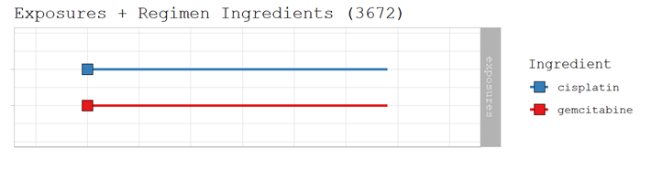
Example 1
Graphical representation

Slide 85
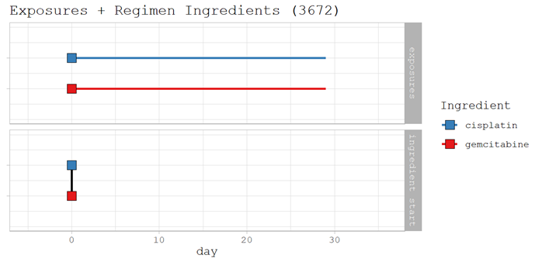
Example 1
Graphical representation

Slide 86
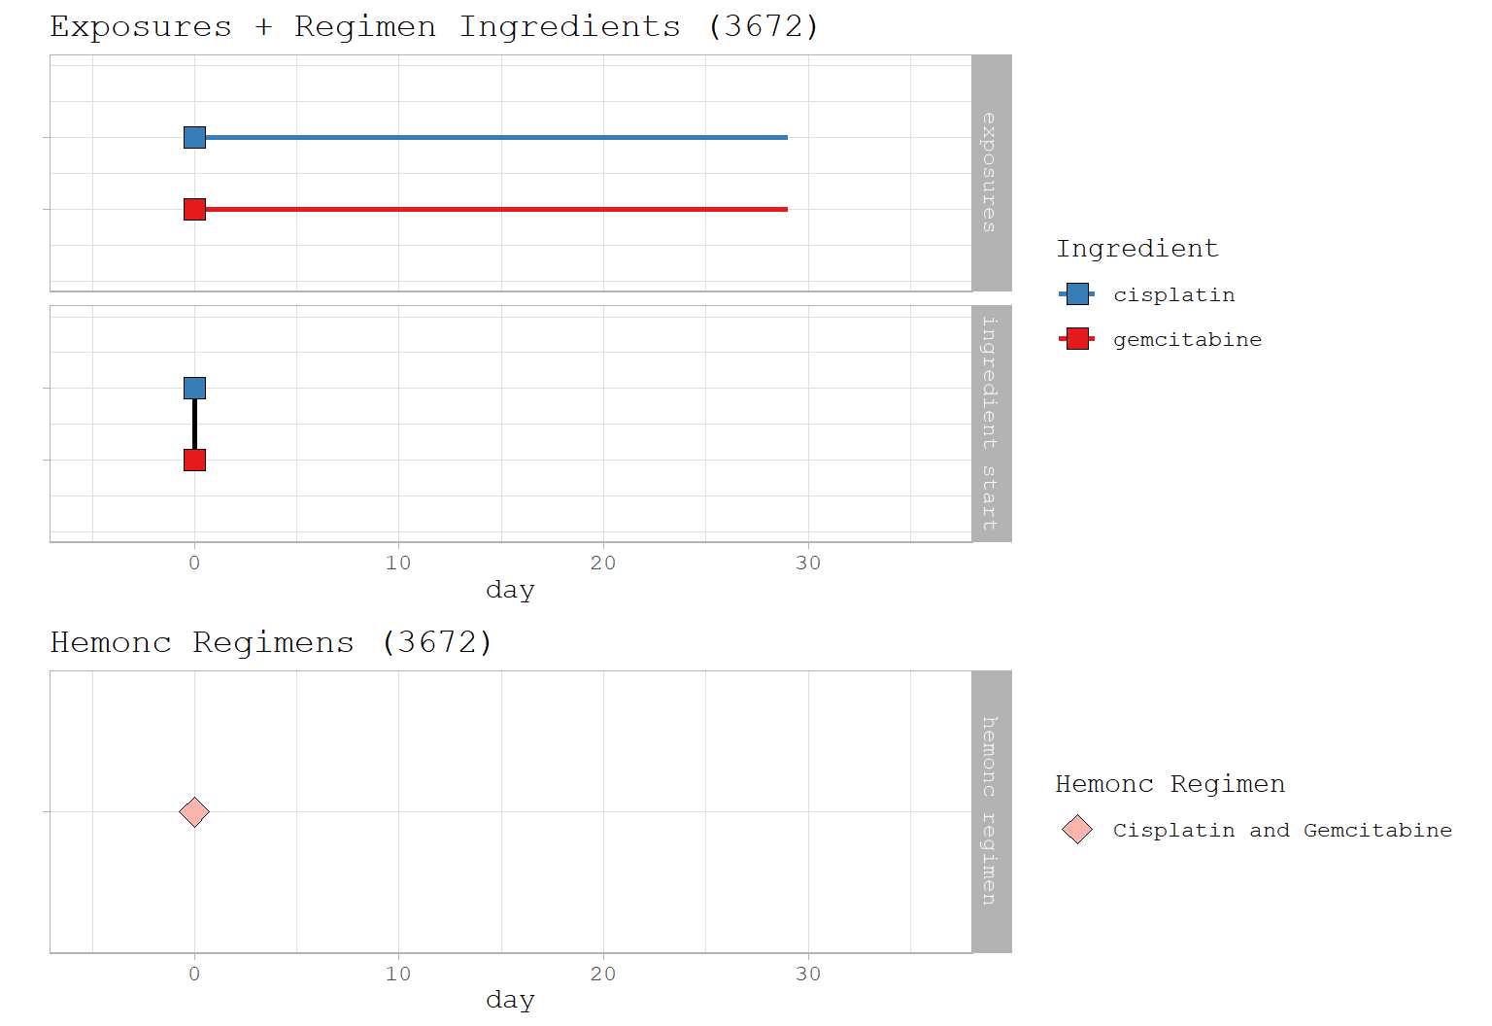
Example 1
Graphical representation

Slide 87
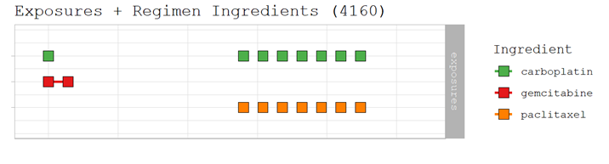
Example 2
Graphical representation

Slide 88
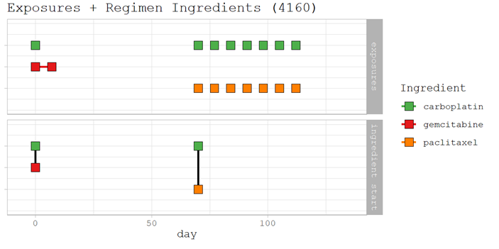
Example 2
Graphical representation

Slide 89
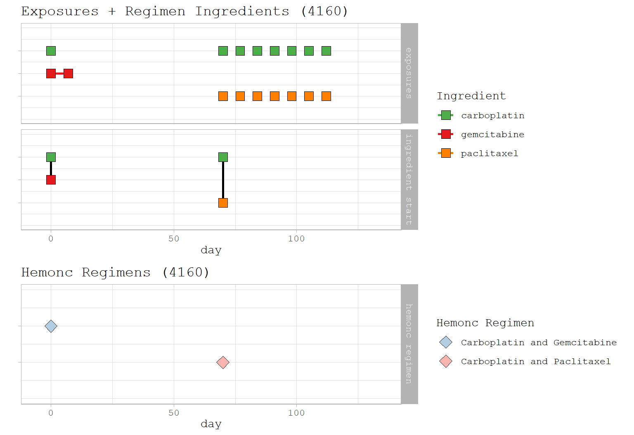
Example 2
Graphical representation

Slide 90
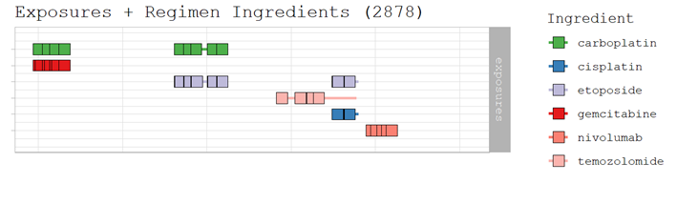
Example 3
Graphical representation

Slide 91
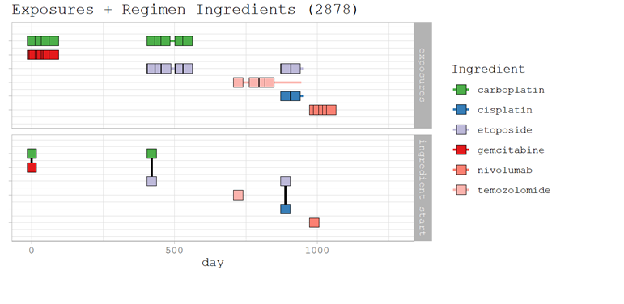
Example 3
Graphical representation

Slide 92
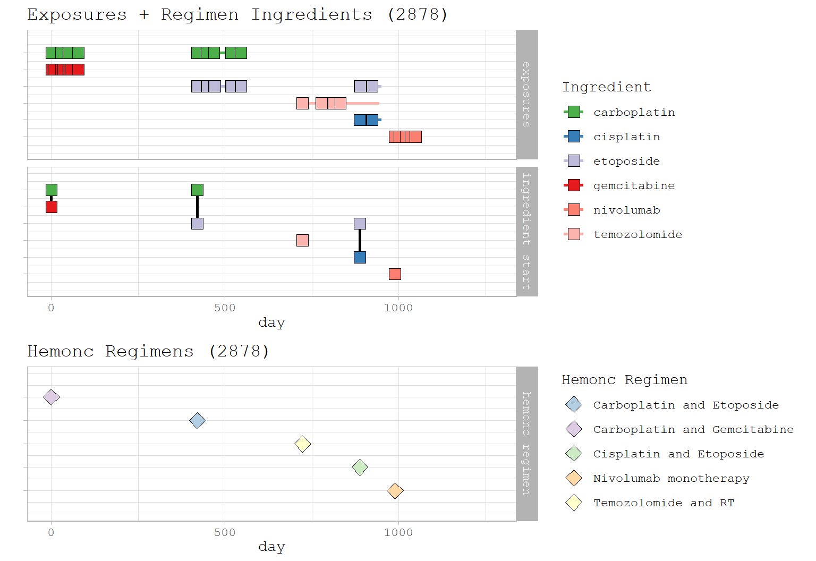
Example 3
Graphical representation

Slide 93
Results

Slide 94
Bladder Cancer PoC
IQVIA Oncology EMR
Regimen | Description
Anti-PD-1 mono | Pembrolizumab monotherapy, Nivolumab monotherapy.
Anti-PD-1 combo | Any regimen that includes either pembrolizumab or nivolumab.
MVAC | The combination of cisplatin, doxorubicin, methotrexate and vinblastine.
Cisplatin + gemcitabine | The combination of cisplatin with gemcitabine.
Other cisplatin | Any regimen that includes cisplatin excluding MVAC and cisplatin plus gemcitabine.
Carboplatin + gemcitabine | The combination of carboplatin and gemcitabine.
Carboplatin | Any regimen that includes carboplatin excluding carboplatin plus gemcitabine
Paclitaxel mono | Paclitaxel monotherapy
Gemcitabine mono | Gemcitabine monotherapy
Other | Any combination of ingredients that does not fall into the previous categories was included in this category.
The categories were chosen based on literature that exists for bladder cancer.

Slide 95
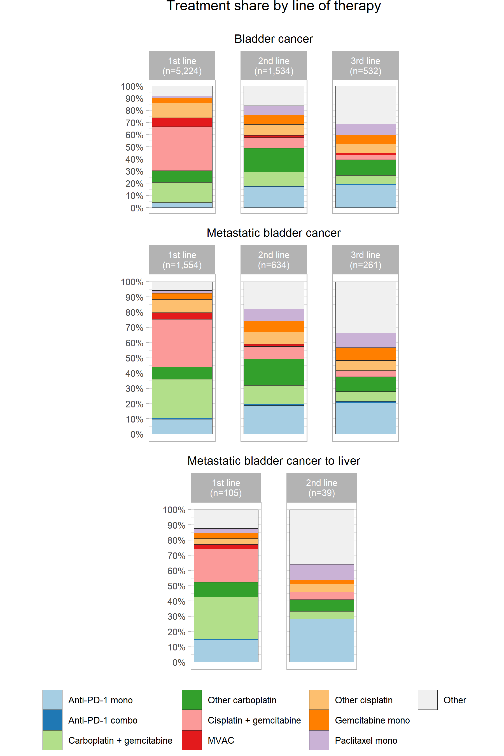
Bladder Cancer PoC
IQVIA Oncology EMR
Regimen | Description
Anti-PD-1 mono | Pembrolizumab monotherapy, Nivolumab monotherapy.
Anti-PD-1 combo | Any regimen that includes either pembrolizumab or nivolumab.
MVAC | The combination of cisplatin, doxorubicin, methotrexate and vinblastine.
Cisplatin + gemcitabine | The combination of cisplatin with gemcitabine.
Other cisplatin | Any regimen that includes cisplatin excluding MVAC and cisplatin plus gemcitabine.
Carboplatin + gemcitabine | The combination of carboplatin and gemcitabine.
Carboplatin | Any regimen that includes carboplatin excluding carboplatin plus gemcitabine
Paclitaxel mono | Paclitaxel monotherapy
Gemcitabine mono | Gemcitabine monotherapy
Other | Any combination of ingredients that does not fall into the previous categories was included in this category.
The categories were chosen based on literature that exists for bladder cancer.

Slide 96
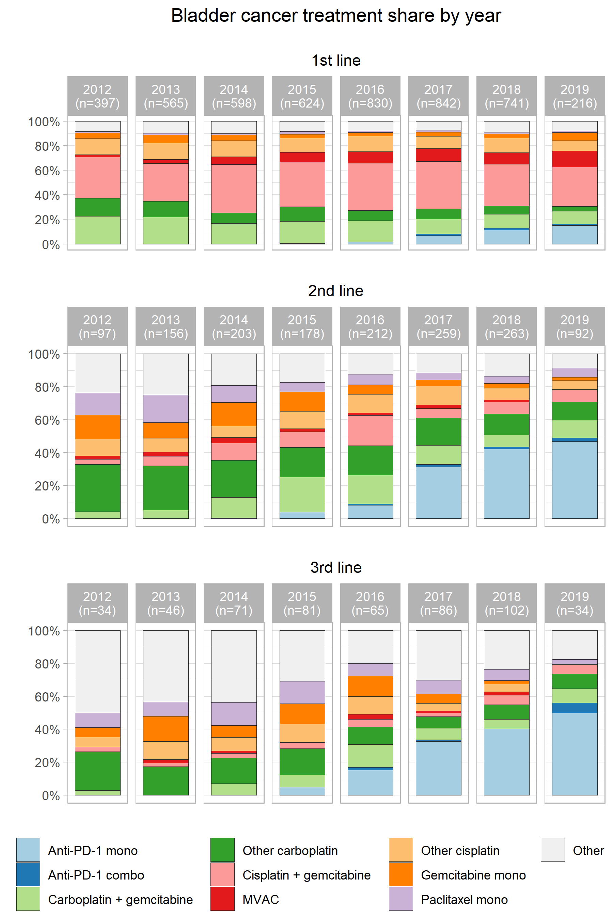

Slide 97
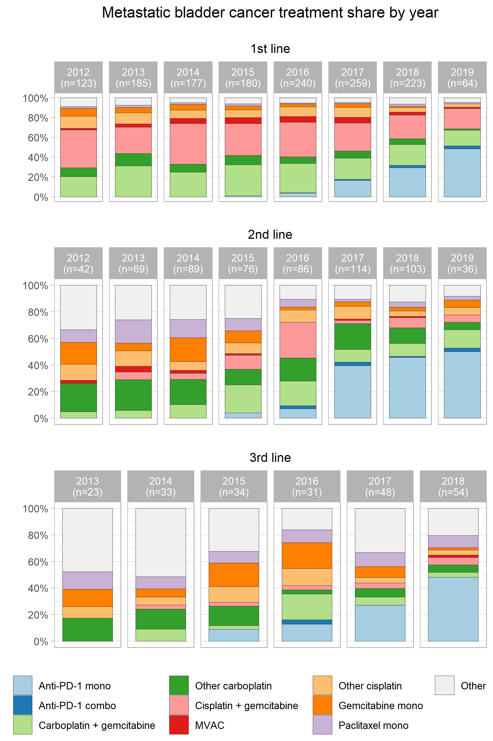

Slide 98
Use Case of the Oncology CDM: Integration of Pieces for Oncology
Seng Chan You MD, MS
Ajou University

Slide 99
Contents
Clinical characterization of the cancer treatment using the Oncology CDM
Cancer Information Retrieval of CDM using text mining application
Integration of genomic and imaging data for oncology

Slide 100
Clinical Characterization Of The Cancer Treatment Using The Oncology CDM
Hokyun Jeon, Seng Chan You MD, MS, Rae Woong Park MD, PhD

Slide 101
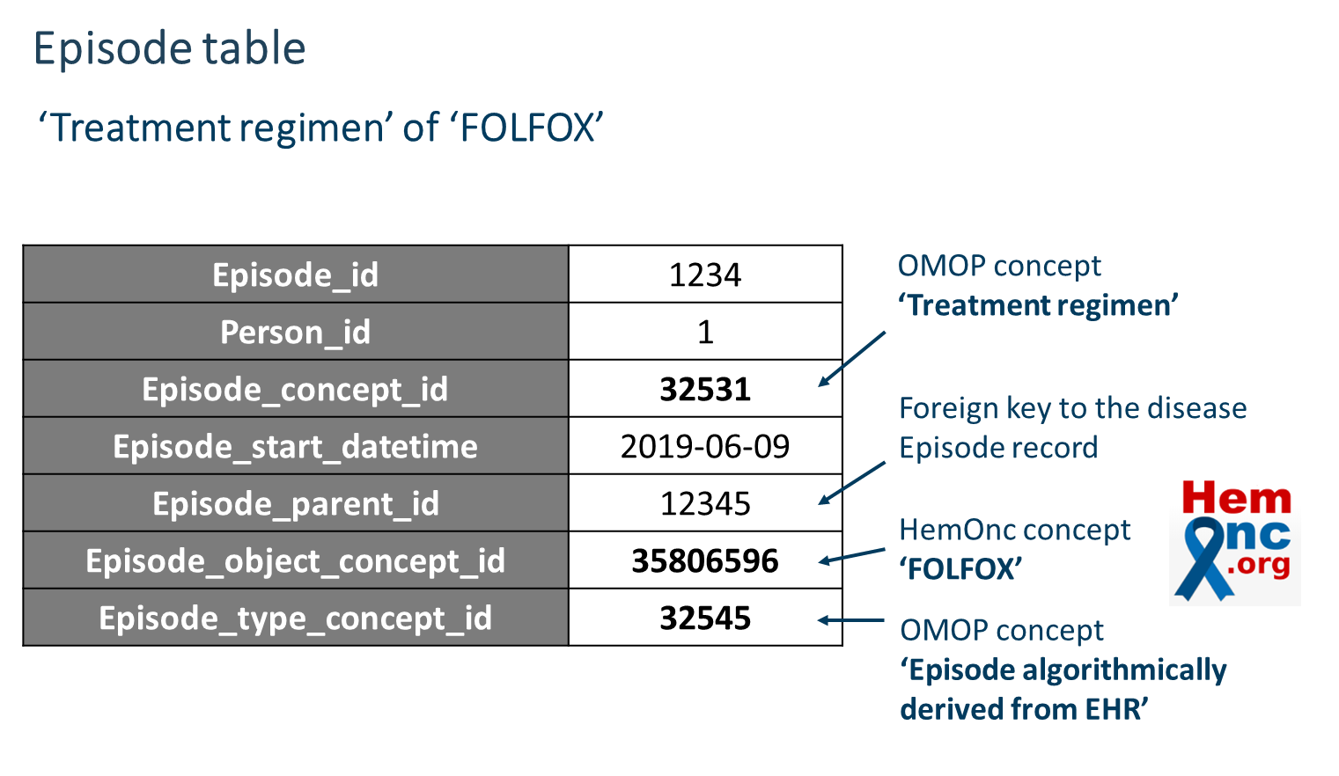
Oncology module : Episode
Oncology working group proposed Episode / Episode_event table to curate treatment records of the cancer patients in Common Data Model.

Slide 102
Oncology module : Episode
The Episode includes :
a record of consecutive chemotherapy (1 treatment line)
a record of each chemotherapy session (called 1 cycle) is included
The Episode_event contains each identifier of the drug records that are related to the episode record.

Slide 103
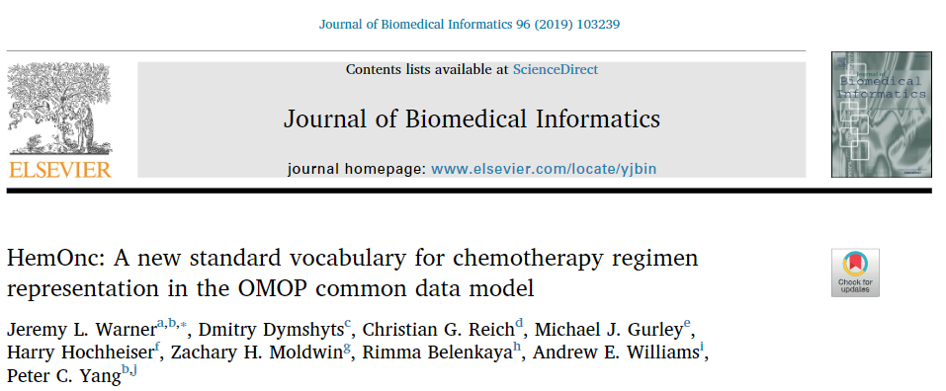
Oncology module : HemOnc
As a standard reference and vocabulary of the chemotherapy regimen, the oncology WG used HemOnc database.

Slide 104
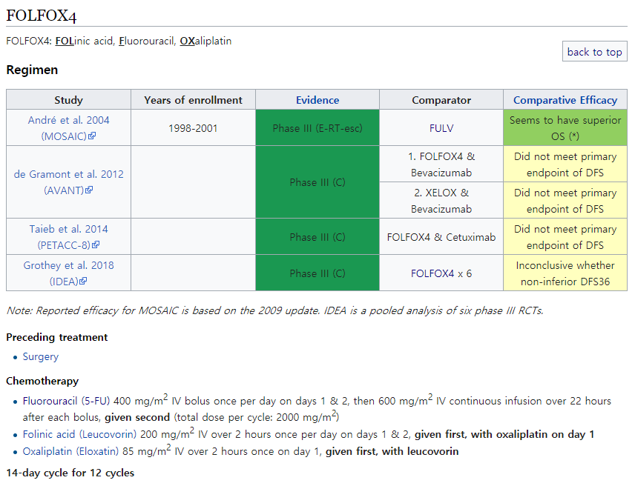

Oncology module : HemOnc
HemOnc Database includes 3,362 of chemotherapy regimen descriptions.
The composition of the drugs in 1 cycle treatment
The recommended number of iteration (Cycle)
A period corresponding to one cycle of each therapy

Slide 105
Objectives
Although the structure for chemotherapy records are constructed by Oncology WG, it is not easy to extract chemotherapy regimen from Electronic Health Records (EHRs) compared to registry data.
Most of the cases, the chemotherapy regimen descripted in narrative medical notes.
Manual process is inevitable to extract chemotherapy regimen information from EHRs.

Slide 106
Objectives
Single medication
5Fu
+
Leucovorin
+
Oxaliplatin
Drug exposure
Therefore, we extracted chemotherapy information to make it possible to seamlessly identify
A single drug level records from episode tables.

Slide 107
Objectives
Treatment Line
FOLFOX
Episode
Treatment Cycle
1st
2nd
3rd
4th
5th
6th
Episode
event
Single medication
5Fu
+
Leucovorin
+
Oxaliplatin
Drug exposure
Therefore, we extracted chemotherapy information to make it possible to seamlessly identify
A single drug level records from episode tables.
Treatment line level records of chemotherapy
Treatment cycle level records

Slide 108
Objectives
Based on the extracted chemotherapy records, the patterns of treatment were identified and visualized.
As a proof-of-concept study to show what we can do by using oncology data and other structured clinical data together, we investigated the association between chemotherapy and onset timing of the adverse event (Neutropenia).

Slide 109
Study Scheme
1. Development of R packages for
A package to extract regimen-level treatment records from EHRs / claim database
An R package to generate Episode / Episode_event table based on extracted treatment
Validation of extracted chemotherapy records
An R package to visualize treatment patterns.
https://github.com/ohdsi-studies/CancerTxPathway
2. Proof-of-concept study:
Identification of the onset of chemotherapy-induced neutropenia after chemotherapy

Slide 110
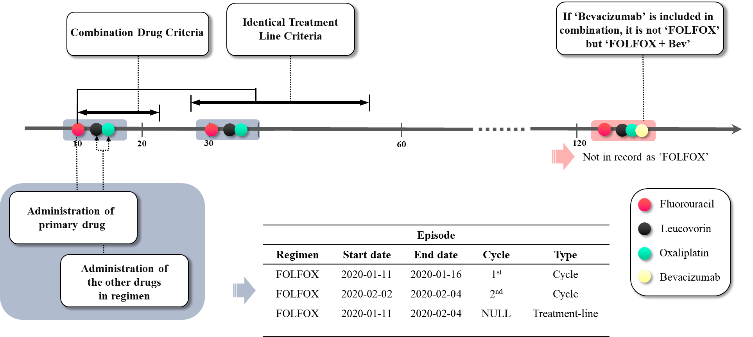
Extraction algorithm
Based on parameterized JSON regimen descriptions, R package extract chemotherapy records considering:
After the dispense date of ‘primary drug’ indexing the first date of chemotherapy, whether the combination drugs of the regimen are dispensed or not.
When each combination of prescribed dates is regard as one cycle, whether the cycles are in the identical treatment line or different treatment line.

Slide 111
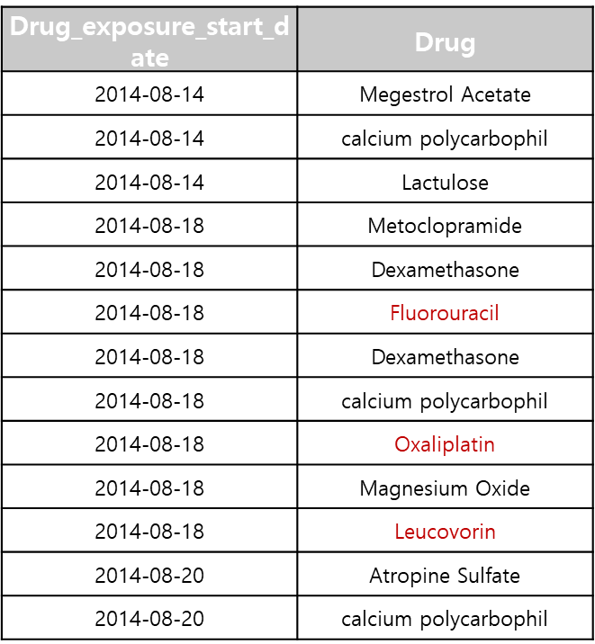

Regimen Records Extraction
Drug Exposure
Treatment Episode table
 | Episode_source_ concept_id | Episode_ Number | Episode_start_ Datetime
FOLFOX | 35804199 | 1 | 2014-08-18
FOLFOX | 35804199 | 2 | 2014-09-14
FOLFOX | 35804199 | 3 | 2014-10-11
We generated an R package for extract chemotherapy regimen records and generate episode / episode_event table from single medication records in the CDM database.
We used HemOnc database as a reference of the regimen and parameterized the regimen descriptions as a JSON (JavaScript Object Notation) to leverage in the package.
https://github.com/ohdsi-studies/CancerTxPathway
Notes:
구조화된 JSON 형태의 요법 정보를 활용하여 기존 CDM내에 존재하는 단일 약물 기록으로 부터 항암 요법 단위의 record를 생성하여 Oncology CDM에서 제안하는 episode 테이블 형태로 생성해주는 알고리즘을 개발하였다.

Slide 112
Algorithm Validation
We validated this algorithm by manual reviewing the clinical notes of 300 patients with colorectal cancer.
Targeted regimens were FOLFOX, FOLFIRI, XELODA .
We confirmed an accuracy for :
The types of regimen are matched to clinical notes.
The repeated cycle number of each patient is matched to clinical notes.

Slide 113
Treatment Pattern
After extracting the chemotherapy record, visualization was performed to confirm the treatment pattern of patients with cancer in colorectal, breast and lung. Visualization results obtains :
A graph of the usage patterns of chemotherapy regimen per year (2010~2018)
A flow chart for the treatment pathway including surgery and chemotherapy
The heatmap for distribution of the patients for chemotherapy iteration number

Slide 114
Results : Algorithm Validation
Table 1. The overall accuracy table of the extract chemotherapy records compared to information in clinical note
Treatment regimen | No information In clinical notes (n) | Regimen type positive predictive value (%) | Iteration number comparison Accuracy (%) | Iteration number Average difference | Iteration number Root Mean Squared Error (RMSE)
FOLFOX | 8 | 100 | 87.0 | 0.3 | 0.64
FOLFIRI | 21 | 100 | 88.6 | 0.4 | 1.36
XELODA | 65 | 100 | 69.0 | 0.65 | 1.5
Table 1 shows accuracy compared the chemotherapy records extracted by the algorithm to chemotherapy identified from the clinical reports.
The types of chemotherapy matched exactly in all cases, and the iteration number of treatments was exactly matched in 81.5% of cases.

Slide 115
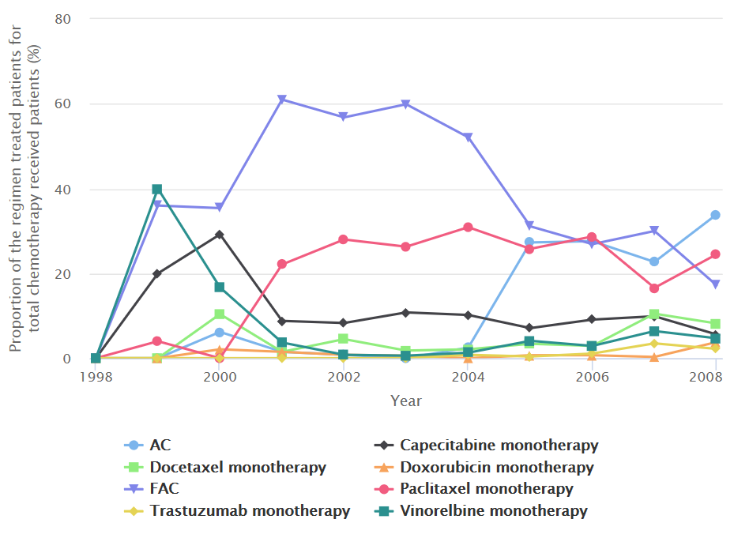
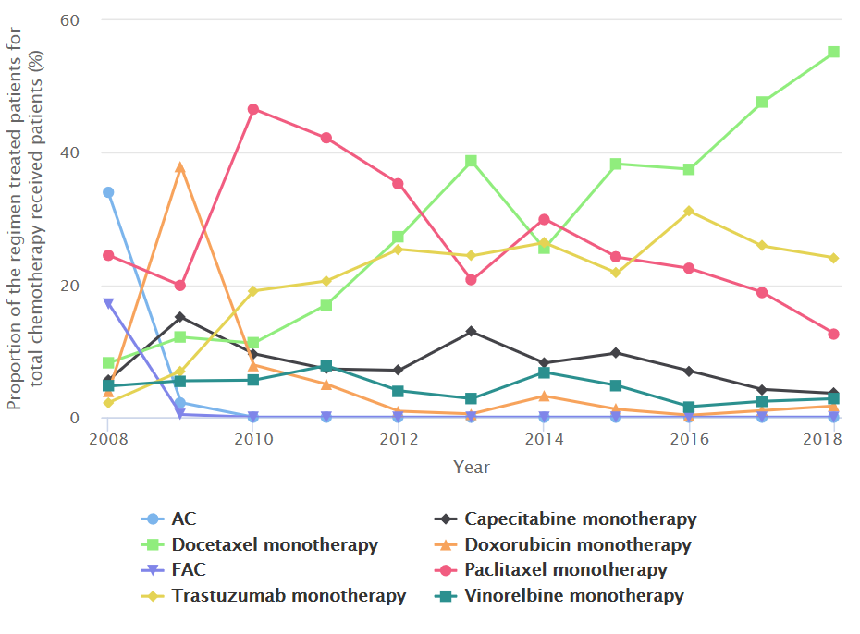
Results : Usage Pattern
(a)
(b)
Figure 1. The usage patterns for each chemotherapy regimen in patients with breast cancer by year
The usage patterns of chemotherapy regimen by year. (a) shows the chemotherapy usage pattern for breast cancer patients from 1998 to 2008 and (b) shows from 2008 to 2018. The graph represents that FAC regimen has been widely used in the past 10 years (1998 ~ 2008), but the use of Docetaxel therapy has gradually increased in recent 10 years (2008 ~ 2018).

Slide 116
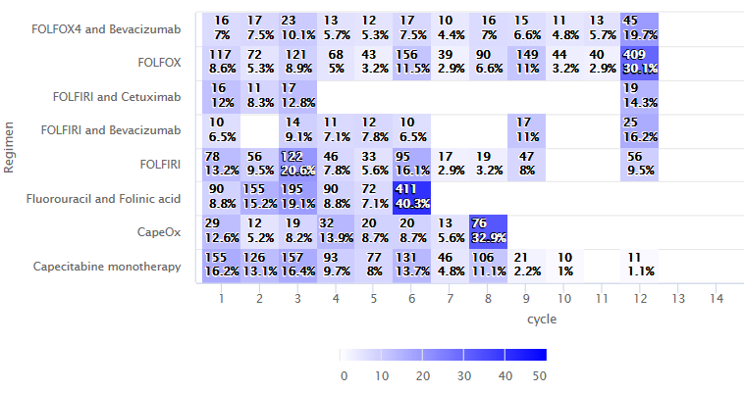
Results : Iteration pattern
Figure 2. Heatmap showing the number of patients by number of treatment iteration in colorectal cancer
The number of patients in each repeated number of treatment in colorectal cancer. The darker the color, the higher the number of patients are distributed. In the example of FOLFOX regimen, most of patients have received 12 cycles, which is consistent with the standard number of iteration recommended in HemOnc.

Slide 117
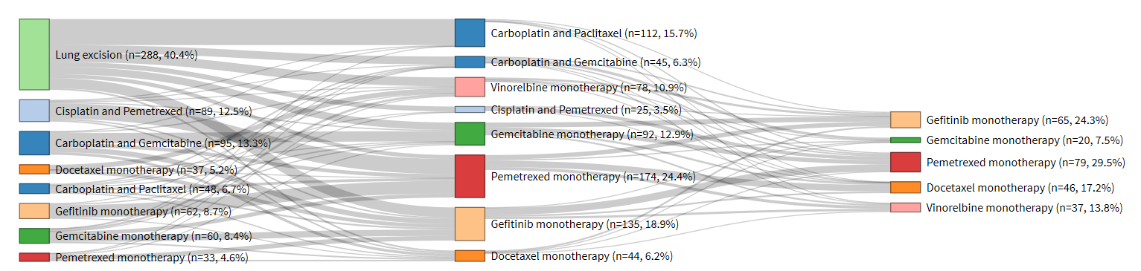
Results : Treatment pathway
Figure 3. A flow chart representing the treatment pathways according to treatment lines in lung cancer patients
A flow chart shows the number of patients in each treatment by treatment line. The chart represents patterns of the treatment change in patients including surgery records. Most people who have had lung surgery receive ‘Carboplatin and Paclitaxel’ as an adjuvant chemotherapy.

Slide 118
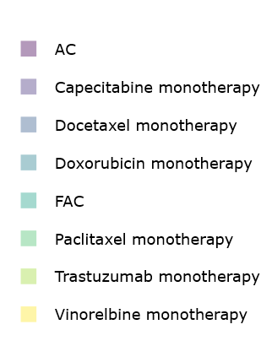
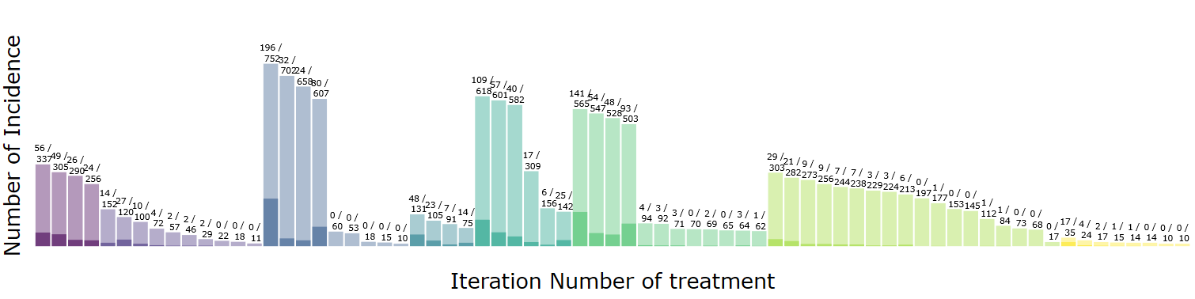
Results : Neutropenia Onset Timing
Figure 4. The proportion of the number of patients with neutropenia onset in each chemotherapy by treatment cycle in breast cancer
Histogram showing how many cycles of chemotherapy were taken until neutropenia occurred for each regimen. The light bars represent the total number of patients treated and the dark bars represent the number of patients with neutropenia.

Slide 119
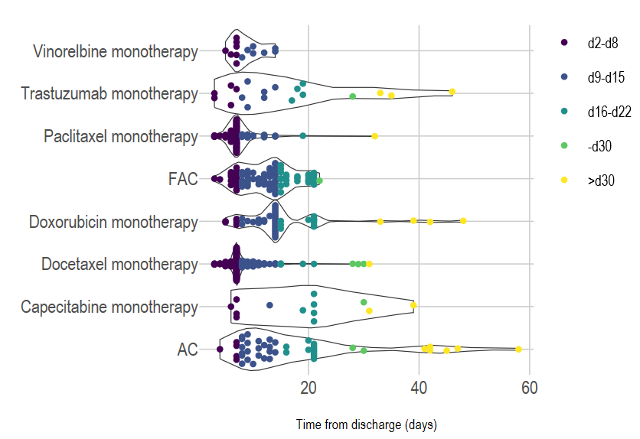
Results : Neutropenia Onset Timing
d7
d14
Figure 5. Time distribution of neutropenia onset after first chemotherapy in breast cancer
Figure 5 shows, by date, the time that neutropenia develops after each first treatment for chemotherapy. In most breast cancer chemotherapies, neutropenia occurs in d7.

Slide 120
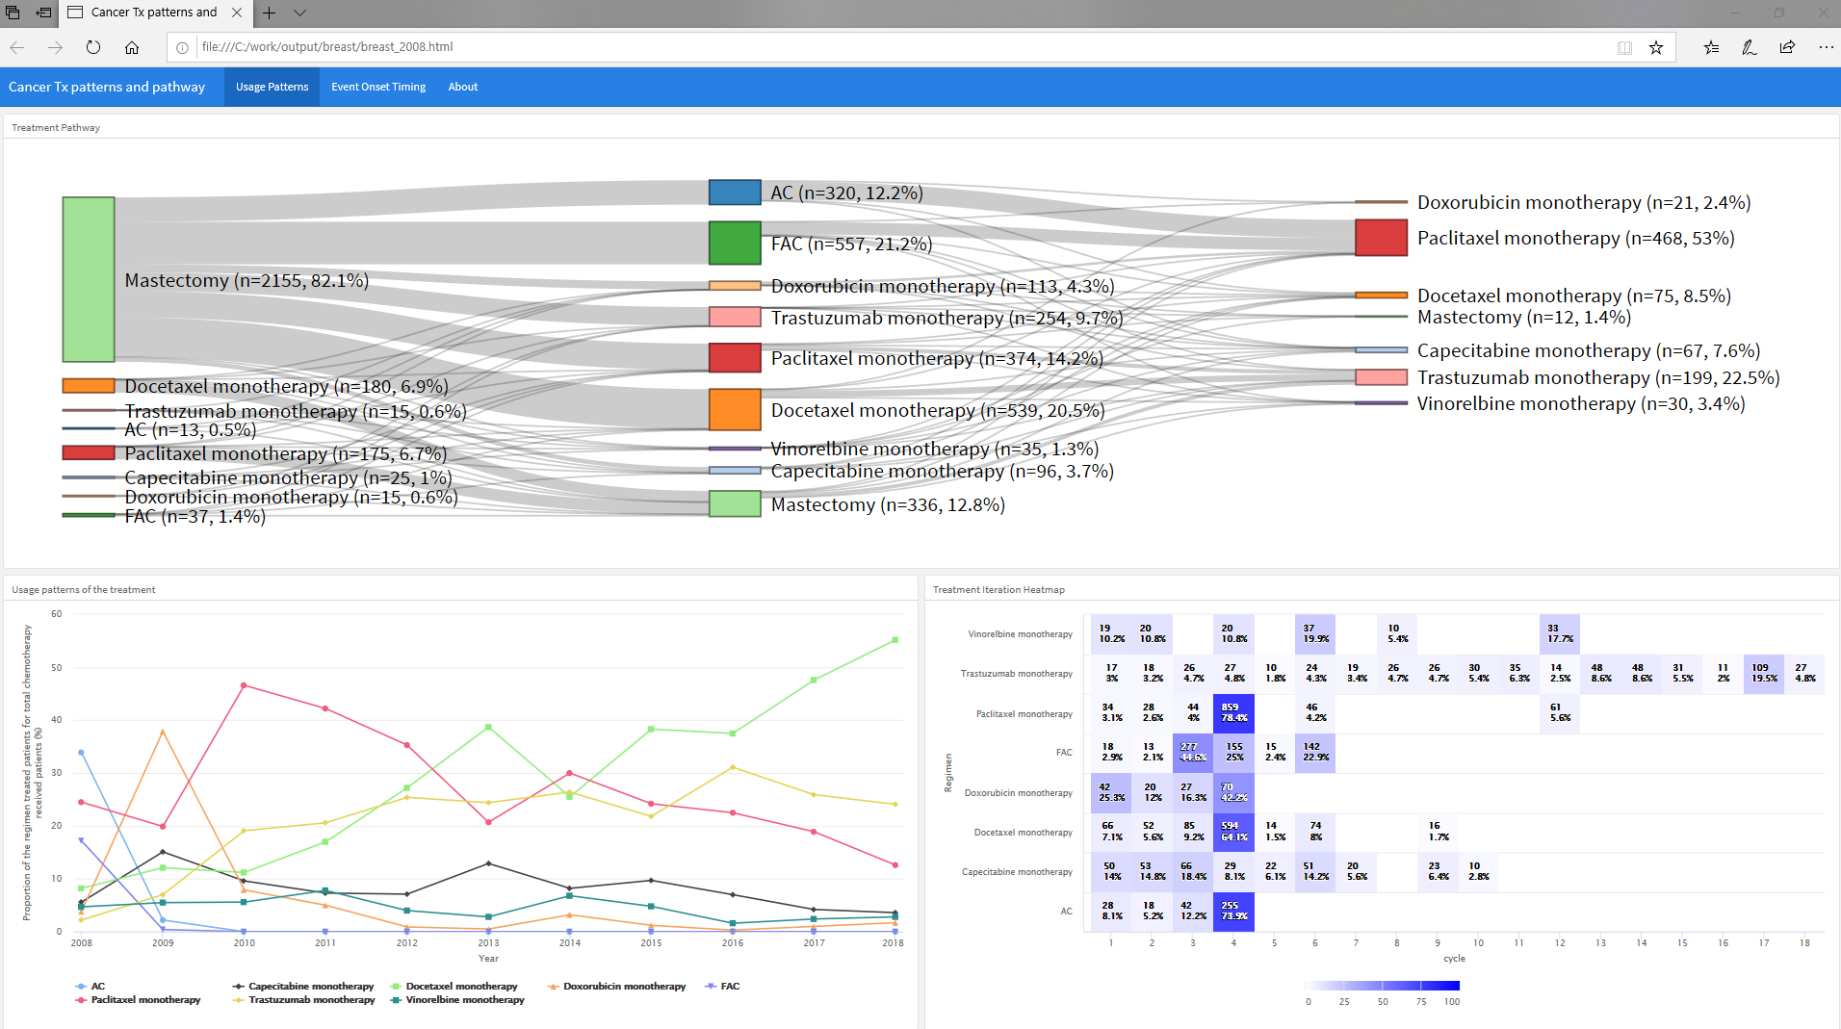
Results : Documentation
All visualization results are interactive figures that can be viewed in a single html file.

Slide 121
Cancer Information Retrieval of CDM Using Text Mining Application
Jimyung Park, Seng Chan You MD, MS, Rae Woong Park MD, PhD

Slide 122



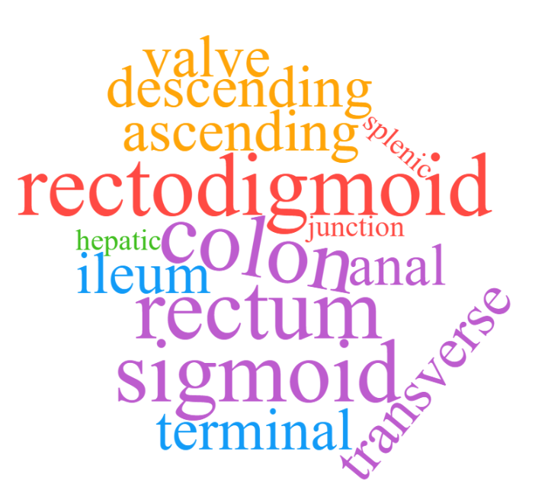
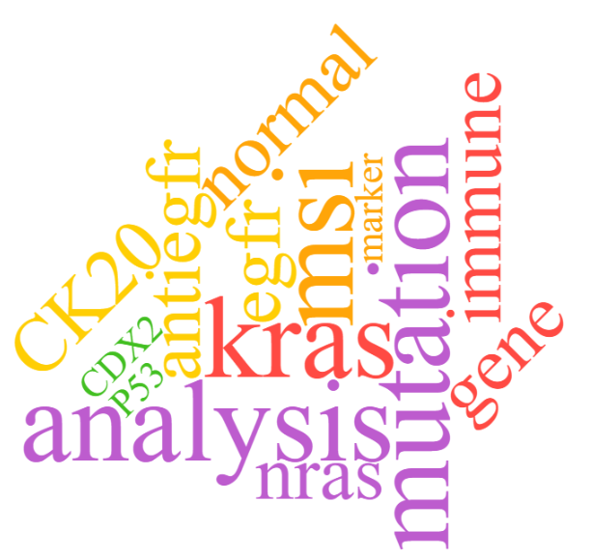
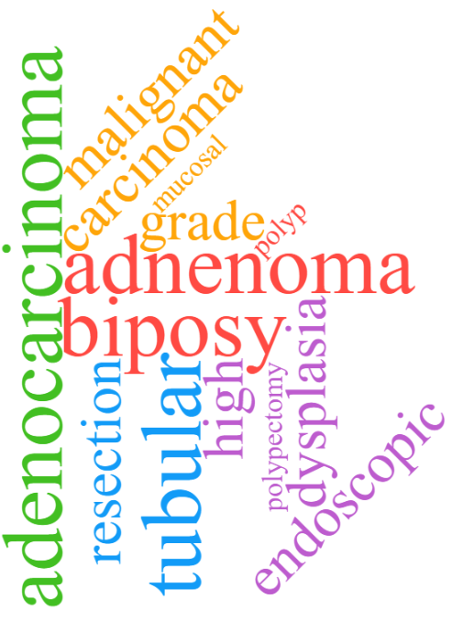

SOCRATex
Text mining pipeline and application for constructing clinical text data lakes
Information Retrieval
Analysis
A Medical Center
B Medical Center
C Medical Center
Phase IV
Extract & Load
Kibana
OMOP - CDM
Elasticsearch
Extract NOTE
Phase I
Phase II
Phase III
removeNonEnglish
anatomic site
Clinical narrative document
removeNumbers
gross, received in formalin. biopsy result, colon, sigmoid, adenocarcinoma, well differentiated. *** additional note) kras mutation analysis.
stripWhitespace
colon pathology
removePunctuation
biomarker
test
anatomic site
…
histology
{
“colon pathology” : {
“anatomic site” : “colon, sigmoid”,
“histology” : “adenocarcinoma”,
“biomarker test” : “kras”
}
}
biomarker test
histology
user-defined dictionary
Preprocessing
Text Clustering
Define Data Structure
Annotation in JSON

Slide 123
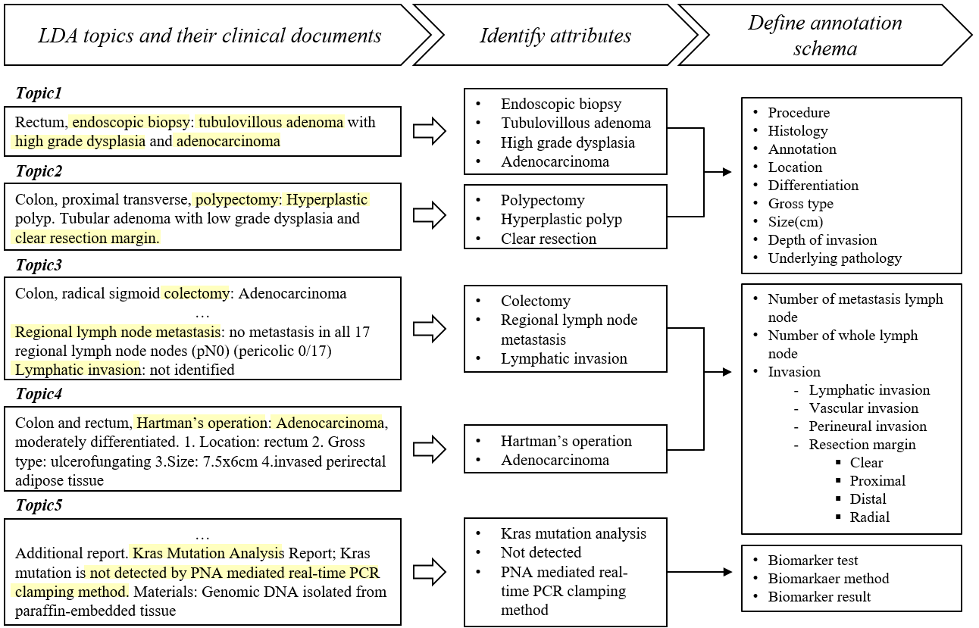
SOCRATex
The number of 600 pathology reports over colorectal cancer were included for the study
We used topic modeling to classify and to define annotation schema without chart review of whole documents

Slide 124
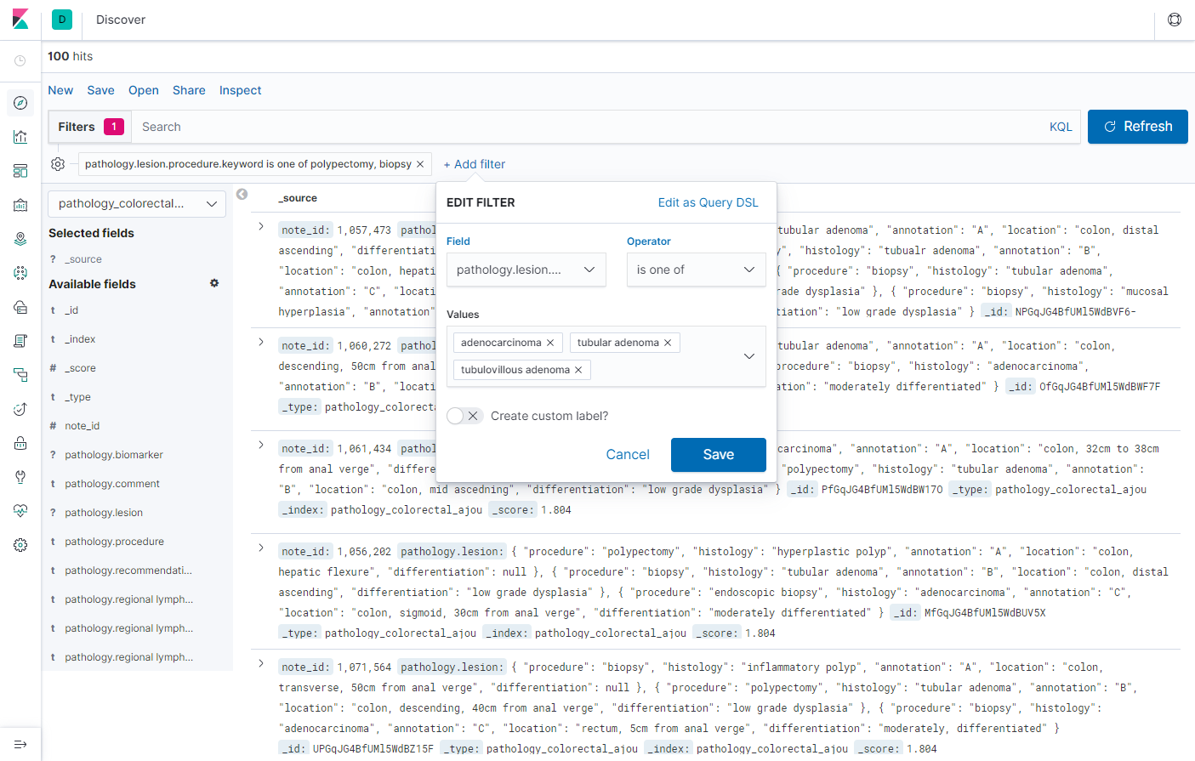
SOCRATex
After manual annotation based on the defined annotation schema, Elastic stack is used for constructing clinical text search engine
Kibana enables query-based text searching and visualization of the reports, resulting in identifying and extracting the information of interest

Slide 125
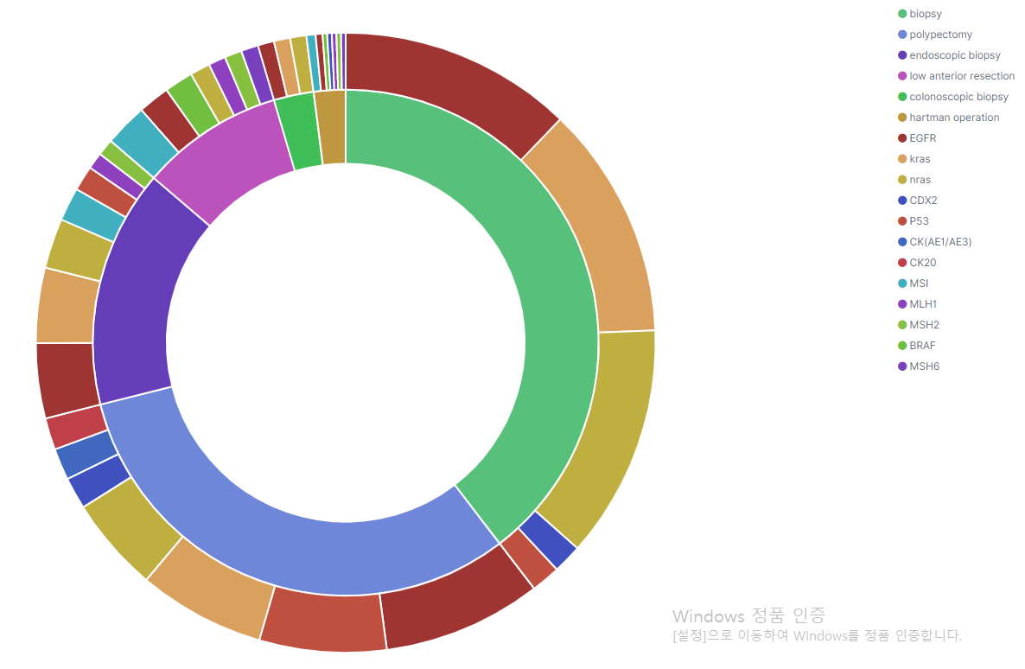
SOCRATex
BRAF
MLH2
EGFR
MLH1
kras
MSI
low anterior resection
endoscopic
biopsy
biopsy
polypectomy
nras
CK20
CDX2
P53
After manual annotation based on the defined annotation schema, Elastic stack is used for constructing clinical text search engine
Kibana enables query-based text searching and visualization of the reports, resulting in identifying and extracting the information of interest

Slide 126
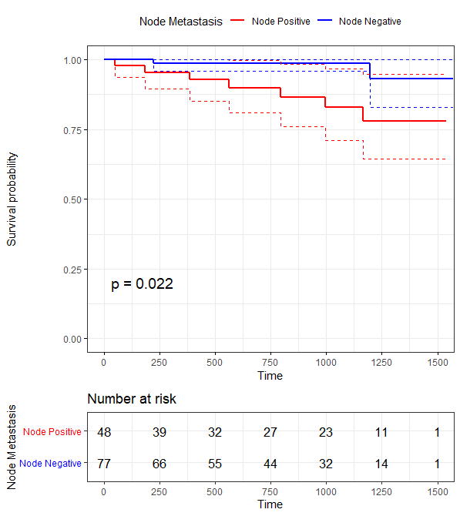
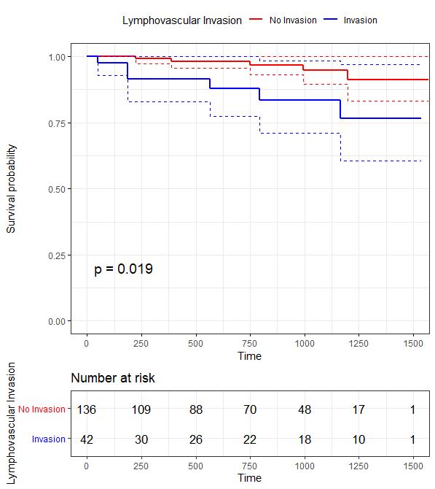
SOCRATex
Since the generated annotations are reusable due to the comprehensive structure, the data could be utilized for various researches
Eventually, we were able to carry out the clinical analysis by combining the unstructured and structured data

Slide 127
Integration of Genomic and Imaging Data For Oncology
Seojeong Shin MS, Seng Chan You MD, MS, Rae Woong Park MD, PhD

Slide 128
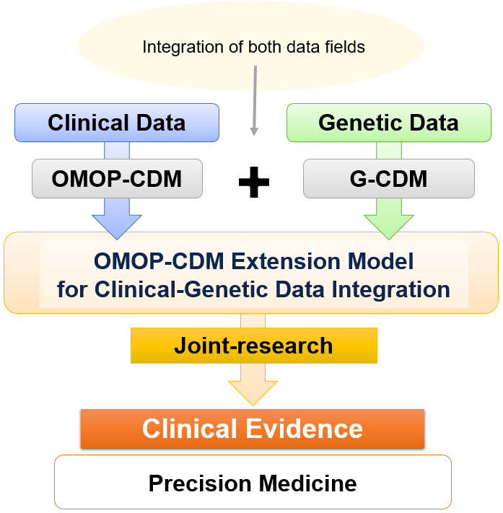
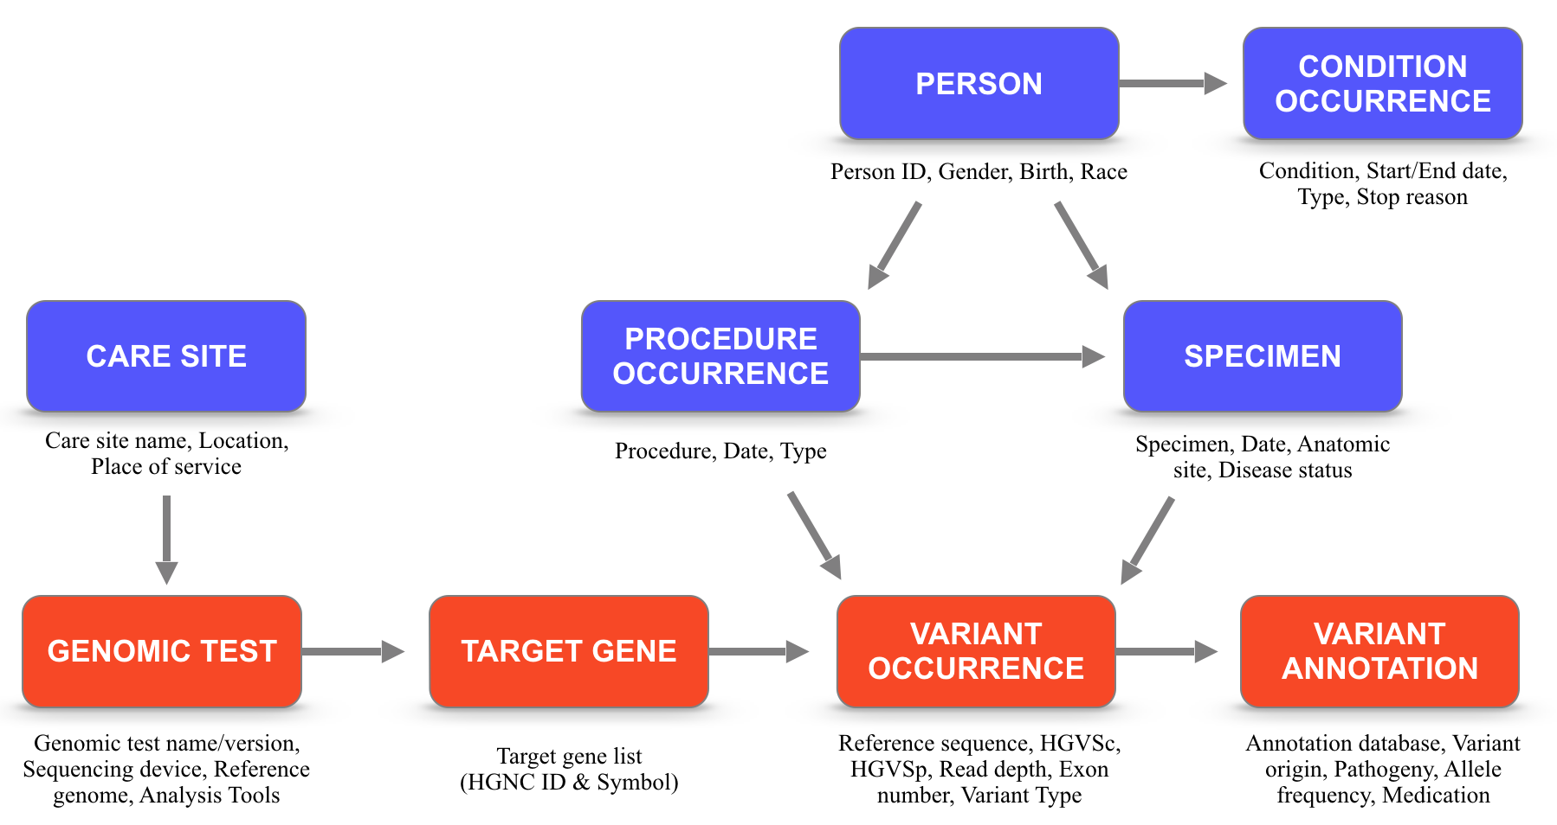
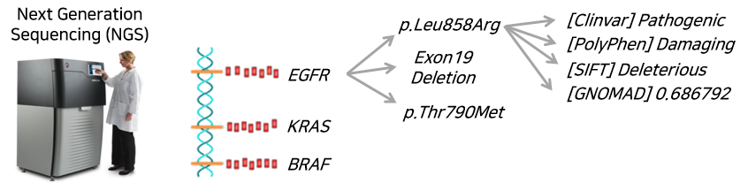
Genomic-CDM
Background
Structure
for Seamless Interoperation
of Biomedical Data in Clinical Practice
OMOP-CDM
G-CDM

Slide 129
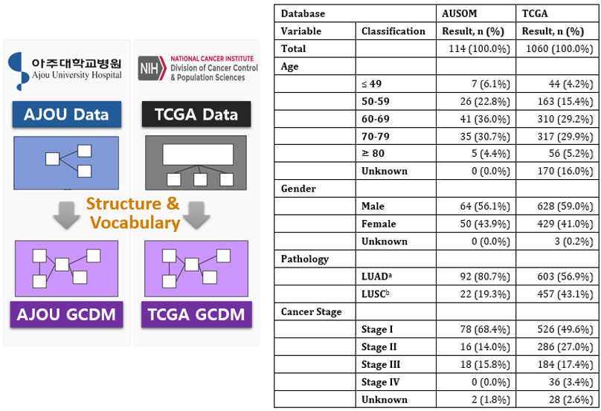

Genomic-CDM
for Seamless Interoperation
of Biomedical Data in Clinical Practice
Model Validation: Comparison of mutation frequency of patients with Lung Cancer
Constant with known knowledge

Slide 130

Image-CDM
Structure
for Seamless Interoperation
of Pathology & Radiology Images and Clinical Data

Slide 131







Image-CDM
Clinical Decision Support System
1) Cancer-region Classification 2) Gene-mutation Prediction
for Seamless Interoperation
of Pathology & Radiology Images and Clinical Data
Cancer-region drawn by pathologists
Cancer-region drawn by the deep learning model
Cancer-rich region
Non-cancer region

Slide 132


























Image-CDM + Cycle GAN
Clinical DecisionSupport System Generalization
Image Style Translation (Cycle GAN)
a) Hospital A
b) Hospital B (before)
c) Hospital B (after)
Performance Generalization
d)

Slide 133









Image-CDM
for Seamless Interoperation
of Pathology & Radiology Images and Clinical Data
Clinical Decision Support System
1) Cancer-region Classification 2) Gene-mutation Prediction
Ovary Cancer
Uterus Cancer
Original Images
Cancer-region
Classification Result
Score
0.0
0.2
0.4
0.6
0.8
1.0
Score
0.0
0.2
0.4
0.6
0.8
1.0
Predicted
Non-cancer
Cancer
Predicted
Non-cancer
Cancer

Slide 134


Image-CDM + Genomic-CDM
Clinical Decision Support System
1) Cancer-region Classification 2) Gene-mutation Prediction
Study Background
Genomic profile comparison

Slide 135


Image-CDM + Genomic-CDM
Clinical Decision Support System
1) Cancer-region Classification 2) Gene-mutation Prediction
Data preparation
Deep learning model building & performance
 | AUMC |  | TCIA
 | Case | Slide | Case | Slide
Total | 34 | 247 | 123 | 566
Non-cancer | 5 | 1,325 | 39 | 276
Cancer | 23 | 1,458 | 84 | 290
BRCA Positive | 6 | 8,087 | 9 | 287
BRCA Negative | 17 | 7,630 | 75 | 288
BRCA
Positive
BRCA
Negative

Slide 136

Data Are Like Lego Bricks for Phenotyping in CDM
Conditions
Drugs
Procedures
Measurements
Observations
Visits

Slide 137
Data are Like Lego Bricks for Phenotyping in CDM
Conditions
Genomic variants
Drugs
Radiology
Procedures
Free-Text
Measurements
Pathology Image
Observations
Oncology
Visits

Slide 138
Conclusions
Although we do have abundant data of clinical narratives, genomics, and images for oncology from cancer registry and EHR, they are scattered in silos across the world
Based on structured data in OMOP-CDM, we can integrate heterogeneous data sources together for oncology.

Slide 139
Norwegian Cancer Registry -Data Sources and Data flow
Siri Larønningen
Special Adviser, Data flow

Slide 140
The Cancer Registry of Norway in a Nutshell
Incidence database (1953 →)
10 clinical registries (2007 →)
Colorectal cancer
Prostate cancer
Breast cancer
Malignant melanoma
Lung cancer
Childhood cancer
Gynecological cancer
Lymphoid malignancies
Oesophagus and ventricular cancer
Sarcomas
Breast cancer screening programme
Cervical cancer screening programme
Colorectal cancer screening programme
Janus Serum Bank

Slide 141







Pathology reports
Clinical information
Radiation therapy
Death certificates and causes of death
Medical Treatment
The Cancer Registry of Norway

Slide 142

D: Diagnostic report
S: Surgery report
R: Radiotherapy
C: Chemotherapy report
H: Hormone therapy report
P: Pathology report
D: Death certificate
N: Patient registry report
Q: Patient questionare
Diagnosis
Time of relapse
Time of metastatic disease
Start of primary treatment
End of primary treatment

Slide 143
Information Model
Person
∞
Cancer case
Data output
∞
Data input
Cancer notification

Slide 144
Data Flow
Data analysis, presentation and warehousing
Data capture
Data curation
Web portal
Prepro-cessing modules
-Attachment managing
-Archiving
-Validation
-AppRec
-Encrypting
-Masking
-Mapping
-Enriching
-Que Management
User applications
Process statistics
Medical Coder
Chief Medical officer
Admin. Pers.
ebXML
XML
Coding manual
Rule Repository
Aggregated data
Rule Engine
Paper forms
Database
Individual data

Slide 145


Slide 146


Slide 147


Slide 148

https://metadata.kreftregisteret.no

Slide 149


Slide 150


Slide 151
Plan for OMOP
Use the ETL from IKNL as template
Try to map
Core variables (all cancer sites)
Prostate cancer variables
Radiation therapy
Medical treatment
Continue co-operating with IKNL
Discuss problems/issues with the OHDSI community

Slide 152

https://github.com/CancerRegistryOfNorway/NORDCAN/wiki

Slide 153
Introduction to IKNL and the Netherlands Cancer Registry (NCR)
Chiara Attanasio, Clinical Data Scientist @IKNL

Slide 154

Agenda
Introduction to the Netherlands Comprehensive Cancer Organization (IKNL)
Introduction to the Netherlands Cancer Registry (NCR) & data flow
What is stored in the NCR
Level of standardization of the NCR
Tumor Specific itemsets
Notes:
- (Check at the end if consistent)
30 min presentation
Add animations
(Consider adding Hans’s slide, with maybe slightly less info (more detailed data flow highlighting also how much we do afterwords)
(Consider showing the excel with the cancer types along with the link)

Slide 155

The Netherlands Comprehensive Cancer Organization
Less cancer
More cure or a longer life
Better quality of life
Improved societal participation
Better palliative care
To reduce the impact of cancer
mission
vision
values
Independent
Data driven and innovative
Determined and flexible
Considerate and driven
Data for Life

Slide 156
















The Netherlands Cancer Registry (NCR)
RANK
250 FTE Data managers, independent, educated
Predominantly manual registration due to lack of EHR interoperability & standardized clinical data
01001011
01001011
125 FTE R&D
Epidemiologist, Clinical Informaticians, Data Scientists, Software Engineers…
±250 peer reviewed scientific publications/y
Annual & special reports
...
..
…
PALGA National
pathology database
Hospital
Electronic Health Records
PROMS*
Municipality
records
NKR online (hospitals)
Data on cancer (public)
patient journey
010101101111011011110
±400 data requests/y
Request review boards
Disease - Care - Outcomes
43M Funds per year
85% Ministry of Health
15% Research funds
Population based
>95% coverage
Tumor Specific Data Sets
Standardized (ICD-O-3, TNM, ATC)
±2.5M patients
±2.9M tumors
±200 items/patient
20 FTE Trusted Advisors
Multidisciplinary tumor teams
*EORTC based questionnaires, cohorts (IKNL PROFILES database)
Notes:
? Is RANK at the correct point ? Where are PROMS and municipality records inserted?

Slide 157
Information Stored in the NCR
The items collected by IKNL for the Netherlands Cancer Registry (NCR) are based on guidelines from the World Health Organisation (WHO) and the International Association of Cancer Registries (IACR).
They can be divided in three itemsets:
Basic itemset A/Kern: This set includes items that are recorded for all cancer patients, regardless of tumor localization, which includes patient demographics and general patient and tumor characteristics (such as diagnostic and initial treatment information).
Basic itemset B: these are tumor-specific items that have been identified in consultation with experts.
Additive itemsets C: this includes special items collected on a project basis on behalf of a specific tumor/tumor group for a given period requiring additional funding.

Slide 158
Overview Items Stored in the NCR
Administrative and demographic data:
patient identification code
Date of birth
gender
postcode when diagnosed
municipality/country of birth
Diagnostic Setting
Institution of treatment
Specialty
Diagnostic data:
imaging examination
laboratory research
pathological examination
other relevant investigations tumor specific (such as HER2, PSA)
Data affecting the choice of treatment or its outcome:
method of discovery
risk factors (of the patient or of treatment)
hereditary abnormalities or other diseases of the patient, at the same time as the cancer in question ('co-morbidity’)
patient's vitality ('performance status’)
Tumor data:
tumor tracking number (indicating the order if a patient has been diagnosed with more than one tumor)
incidence date (= date of diagnosis)
basis for diagnosis
topography and lateralization
remote metastases
multifocality
morphology
degree of differentiation, WHO degree brain tumors
number of/positive lymph nodes examined
stage of the disease:
cTN
(y)pTNM
tumor expansion (if TNM does not apply).
tumor residue after surgery
Treatment data:
initial treatment, recurrence treatment/second-line treatment
(nature) surgery of the primary tumor (including
'open-close') and/or regional lymph nodes (lymph)
node dissection or sentinel gland biopsy), surgical
technique
radiotherapy (external, interstitiated, combination, dose, irradiation fields)
(type) chemotherapy (primary, adjuvant, neo-adjuvant, dose)
(type) hormonal therapy
(type) immunotherapy
other therapy
no treatment, waiting policy
(start)date treatment
side effects and any adjustments to treatment
treatment in study
The order of all treatments is also recorded. For each type of cancer, the most common surgical operations are distinguished.
Follow-up data:
patient status, indicates whether the patient is alive
date progression/recurrence, localization of recurrence
date/date last contact/emigration date

Slide 159








Standardization in the NCR
Information according to IKNL/National standards
IKNL: pathology (w\ Palga), treatments
Vektis standards: diagnostic operations, surgical operations, institution
G-Standaard: medications
ROO: radiotherapy
Information according to international standards
ICD-O: oncologic diagnosis
ICD: other diagnosis or comorbidity
TNM, FIGO, Ann Arbor, EOD: staging
Loinc: clinical chemical lab
ATC: medications (secondary w.r.t. G-Standaard)

Slide 160
Tumor Specific Itemsets
Itemset pancreascarcinoom / alvleesklierkanker
Neuro-oncology
Itemset NKR gliomen
Itemset NKR meningeomen
Itemset NKR hypofysetumoren
Skin cancer
Itemset NKR basaalcelcarcinoom
Itemset NKR plaveiselcelcarcinoom
Itemset NKR melanoom
Genitourinal cancer
Itemset NKR prostaatkanker
Itemset NKR blaaskanker
Itemset NKR project BlaZIB
Itemset NKR nierkanker
Itemset NKR nierbekken- en ureterkanker
Itemset NKR urethra en overige urinewegen
Itemset NKR zaadbalkanker
Itemset NKR peniskanker
Hemato-oncologie
Itemset NKR AL amyloïdose
Itemset NKR Acute Myeloïde Leukemie
Itemset NKR Acute Lymfatische Leukemie
Itemset NKR Chronic Lymphoblastic Leukemia
Itemset NKR Chronic Myeloid Leukemia
Itemset NKR Cutane Lymfomen
Itemset NKR Histiocytaire en dentrische celsarcomen
Itemset NKR Hodgkinlymfoom
Itemset NKR Mastocytose
Itemset NKR Myelodysplastisch syndroom
Itemset NKR Myelofibrose
Itemset NKR Non Hodgkinlymfoom
Itemset NKR Plasmaceltumoren
Itemset NKR PV en ET
Solid tumors
Itemset NKR mammacarcinoom
Itemset NKR bot- en wekedelensarcomen
Itemset NKR hoofd-halskanker
Itemset NKR longkanker (c34)
Itemset NKR schildklierkanker
Gynaecological cancer
Itemset NKR ovariumcarcinoom
Itemset NKR endometriumcarcinoom
Itemset NKR cervixcarcinoom
Itemset NKR vulvacarcinoom
Cancer of the digestive organs
Itemset slokdarm- en maagcarcinoom
Itemset NKR dunnedarmkanker
Itemset NKR dikkedarmkanker (coloncarcinoom)
Itemset NKR endeldarmkanker (rectumcarcinoom)
Itemset NKR anuskanker

Slide 161


Example – Prostate

Slide 162



Example- Prostate

Slide 163
First Experience with OMOP Oncology Extension ETL
Peter Prinsen, Chiara Attanasio

Slide 164

Going FAIR and the OMOP-CDM
IKNL gets many data requests. Due to lack of information about our data the request process is inefficient and people are discouraged from making requests.
Part of the NCR data follows international standards (ICD-O, TNM), part does not (treatments for example). This incomplete standardization complicates replicability and (international) collaborations.
Due to privacy concerns, federated learning will gain in importance. Standardization is crucial for this.

Slide 165
OMOP Oncology Extension
diagnosis
modifier
disease and treatment episodes
disease
underlying events
treatment regimen
Person
treatment cycles

Slide 166
IKNL ETL: Table Entries
episode event table
person table
episode table
condition occurrence table
measurement table
episode event
condition occurrence
cT
disease
person
cN
…
TNM version
cT copy
cN copy
…
treatment regimen
TNM version copy
treatments not yet converted to standard concepts

Slide 167



Strategy
Identify item to transform
Determine transformation (use Athena, http://athena.ohdsi.org/)
Document
Implement
Start with person table, then add episodes, then modifiers.
Destination field | Destination value | Transformation & Remarks
gender_concept_id | GID | Transformation: Gender in NKR can be found in DimPatient: GeslachtCode. For the translation table from DimPatient: GeslachtCode to GID see section 2.5.3. Hermaphrodite patients (GeslachtCode 3) are dropped. Remarks: For the OMOP-CDM gender codes see 2.5.1. For the NKR gender codes see section 2.5.2. If we do a count in DimPatient on GeslachtCode we only get 1, 2, and 3 (plus two with a NULL value but they seem to be fake patients (PatientID -1 and -2)). The reason hermaphrodite patients are dropped is that there are very few so there are issues with “herleidbaarheid”. NKR analyse also drops these patients in any data request (MvM). Refer to NKR analyse document (see email Marianne). Gender is mandatory in both NKR and OMOP-CDM. Gender refers to gender at birth in both NKR, see (5), and in OMOP-CDM (see (1), section 5.6.1). Why is GeslachtCode used in DimPatient and not GeslachtID?

Slide 168
Issues Encountered
Most of the work is in understanding our own data, codes used, etc.
There are minor issues related to the OMOP-CDM (mainly Ocology Extension and vocabulary) and our understanding of it (but Oncology WG is very willing to help!):
No standard concept for hermaphrodite → we drop those patients
Understanding of link between Measurement and Meas Value
TNM (and other modifiers?) under active development:
Now Episode and Condition Occurrence can each have only one TNM edition. In the future TNM edition will be precoordinated in Snomed with the type (clinical/pathological T, N, M, or stage) so each modifier has its own edition.
The vocabulary currently only has TNM 7. This will be expanded with 5, 6, and 8 (we have indicated that we have 3 and 4 too).
AJCC or UICC cannot be indicated at the moment. In the future one will be chosen as standard and the other will be mapped.
We have our own list of treatments so we need to transform those (not yet started)

Slide 169
Next steps
Implementation of ETL in datawarehouse
Started yesterday (creation of tables and import of vocabulary)
Continue adding new items
Create use cases

Slide 170
PIONEER’s Experience with OMOP

Slide 171
Introducing PIONEER

Slide 172
IMI: Background

Slide 173
PIONEER Consortium

Slide 174
PIONEER’s Objectives

Slide 175
Data Network
Registries converted to OMOP
ERSPC – European Randomized Study of Screening for Prostate Cancer
PRIAS - Prostate cancer Research
International: Active Surveillance

Slide 176
Data Network
Next: Clinical Trial
Placebo arm of PCa trial
Coming up, registries from:
Sweden (Malmö)
The Netherlands (Nijmegen)
UK
…

Slide 178
Extensions
Oncology extension
Episode + Episode Event for a.o. lesions and biopsies
No NAACCR vocabulary
Clinical Trial conventions
Trial visits
Condition/measurement modifiers

Slide 179
How Can You Contribute

Slide 180
Thank You!

Slide 181
SEER and OMOP
Angela Mariotto
Chief Data Analytics Branch

Slide 182

SEER has expanded in 2018:
New SEER areas include Massachusetts, New York, Wisconsin, and Idaho

Slide 183

SEER Collects
Demographic: age, gender, area of residence, race and ethnicity,
Tumor (cancer) identification:
Date, sequence number, diagnostic confirmation
Site and morphology (ICD-0-3) (Site, histology, behavior, grade)
Extent of disease (Size, extension, nodal involvement, metastases): stage
Site specific factors (tumor markers): Estrogen receptor, progesterone receptor, HER2
Initial treatment: surgery (SEER recode)
Outcome (follow-up for vital status): living or deceased, month and year of death and cause of death
SEER data is linked at the county level with Census data and provide socio-economic variables at the county of residency
Data is consolidated and available for analyses in SEER*Stat

Slide 184
Types of variables in SEER
Patient information
Age, location, race, ethnicity
Reference information
Coding system in place, type of follow up, reporting source
Identification
Date, sequence number, diagnostic confirmation
Site and morphology (ICD-0-3)
Site, histology, behavior, grade
Extent of disease (staging)
Size, extension, nodal involvement, metastases
Site specific factors (tumor markers)
Estrogen receptor, progesterone receptor, HER2
Initial treatment
Surgery, radiation
Outcomes
Mortality, censoring (loss to follow up)

Slide 185
SEER Research Files
Different files that depend on the number years and vary with respect to Geography
SEER-9 cases diagnosed in1975-2016
SEER-18 cases diagnosed in 2000-2016
Research files approximately 190 fields
Most are “recodes” from:
ICD-O-3 tumor classification (location, histology, behavior, grade)
E.g. AYA site recode, childhood site recode, …
Extent of disease fields used in different years

Slide 186
SEER in OMOP?
Initial Considerations

Slide 187
Project Goal
Collaboration with Outcomes Insight (Mark Danese) in 2016-2017
Explore the feasibility of putting SEER data into the OMOP data model
Identify key SEER data to be included
Identify possible mappings to use
Determine how to link information together by tumor

Slide 188
OMOP Data Model
Not really built for cancer registry data
Organizes information by type
Drugs
Conditions
Procedures
Measurements
Costs
Organizes all data around a “visit”
EHR-centric approach
Maps all codes (e.g., ICD9) to a “standard” representation

Slide 189
Progress and Issues
We were able to map about 2/3 of the public use SEER data (excluding site specific data) to “standardized” vocabularies
Primarily LOINC
ICD-O-3 is essentially a “pre-coordinated” expression
It has multiple parts
OMOP doesn’t easily support multiple codes on one record
There are multiple options, but all have limitations
SNOMED doesn’t handle cancers as elegantly as ICD-O-3
It isn’t designed for cancer registries
Slide courtesy of Mark Danese

Slide 190
Conclusions
OMOP CDM can be made to work
Information can be organized by “visit” (diagnosis)
Mappings can probably be solved (there is an oncology working group in OHDSI)
The value of mapping from well-understood and expressive oncology vocabularies is questionable
LOINC is really just a numeric code for vocabularies that already exist in oncology (SEER) data
SNOMED isn’t the best choice for classifying cancers (ICD-O-3 is better)
A data model that is flexible and avoids the requirement for mapping might be a better choice
Slide courtesy of Mark Danese

